Slide 1
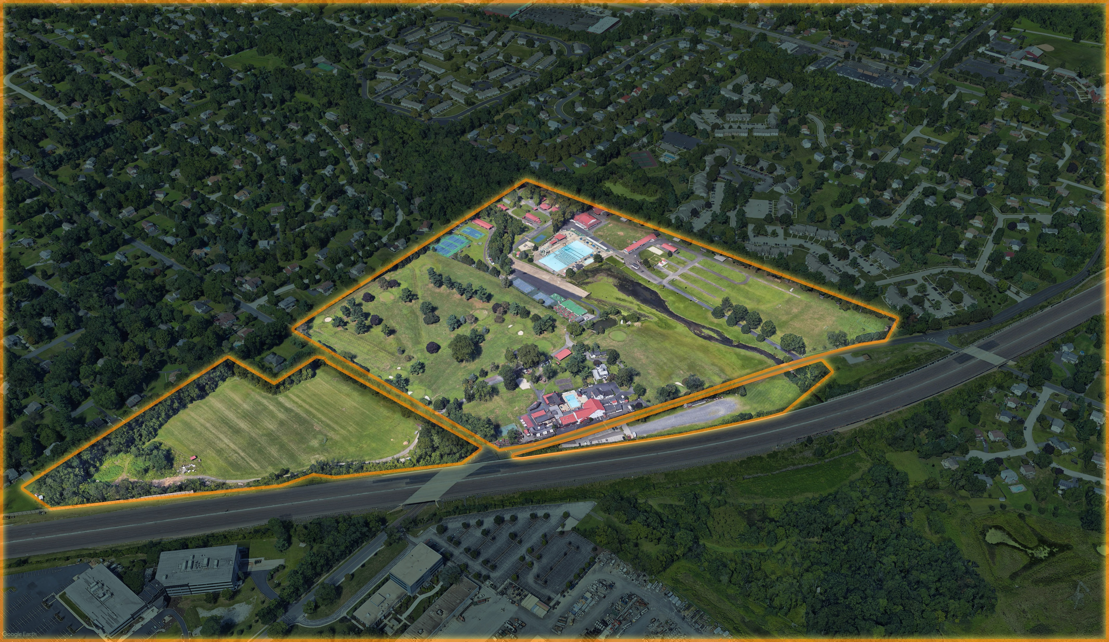

Welcome to
Public Meeting 1
January 25, 2021
7PM to 9 PM
Thank you for your time!
Notes:
Pete

Slide 2
Structure for Tonight’s Meeting
This will be a 30-minute presentation
As you think of questions during the presentation please type them into the CHAT function
Some of your questions may be answered during the presentation so you may want to wait until our presentation is completed.
The bulk of the meeting will be spent listening to your questions and your suggestions for the new park
This presentation will be posted to the Township web site in a day or two
Please feel free to contact Simone Collins over the duration of the project. Our contact information is at the end of this presentation
Notes:
Pete

Slide 3
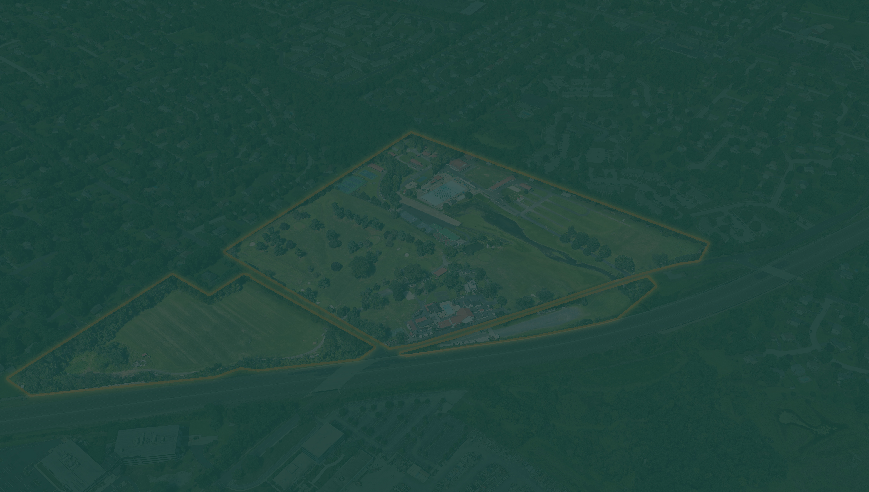
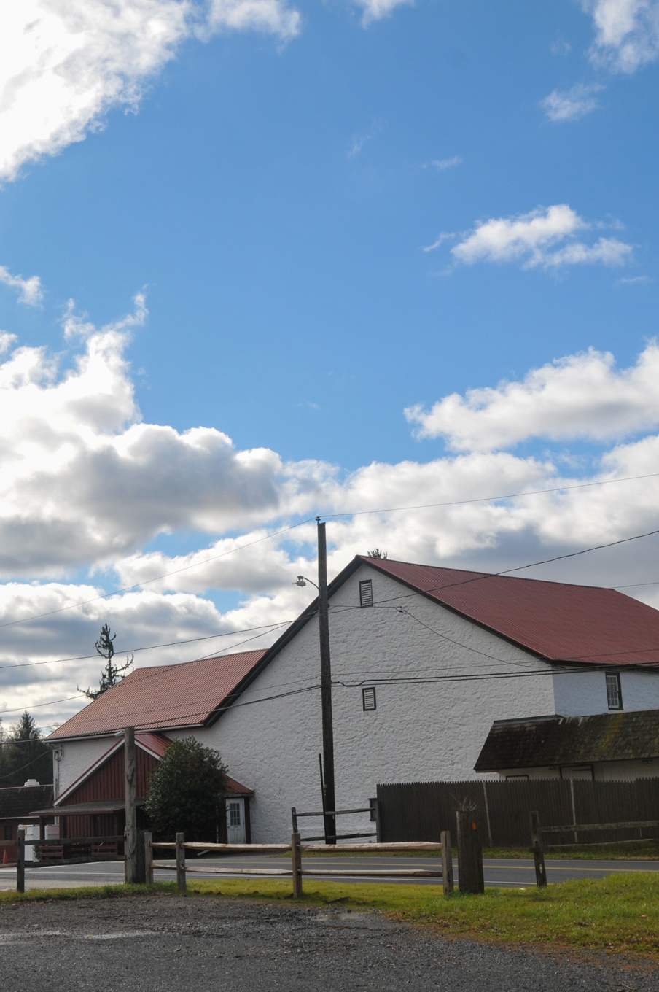
Meeting Agenda
Steering Committee
Consultant Introductions
Master Plan Process
Project Schedule
Project Scope
Site Overview
Preliminary Market Study
Brainstorming / Q&A
Next Steps
Notes:
Pete

Slide 4
Michele Minnick | Board of Supervisors
Fred Conner | Board of Supervisors
Roman Pronczak | Township Manager
Dave Mrochko | Assist. Township Manager
Jim Blanch | Engineering Director
Tom Farzetta | Public Works Director
Travis DeCaro | Project Coordinator
Kurt Baker | Parks & Recreation Director
Mike Richino | Parks & Recreation Director
Courtney Meehan | Program Coordinator Parks & Recreation
Marshall Bleefeld | Park & OS Board/School Dist.
Angela Dougherty | Park & OS Board/AWJFA
Sandi Feltes | Park & OS Board alternate
Sean O'Donnell | Comp Plan Committee/WRA
John Ferro | Comp Plan Committee/Wiss Trails
Melissa Brown | Comp Plan Committee/Inclusion
Edgar David | Shade Tree Commission - Chair
Natalie Macy | Planning Commission
Harry Phifer | Zoning Hearing Board
Daniel Ronca | Zoning Hearing Board Alternate
Bob Trejo | Boy Scout Troop 98 - Resident
Joe Smallberger | Boy Scout Troop 117 - Resident
Connie Morgenson | Resident
Victoria Hyczko | Resident
Margaret Phiambolis (Sibby) | Resident
A Luis Lozado | Resident
Steering Committee
Notes:
Pete

Slide 5
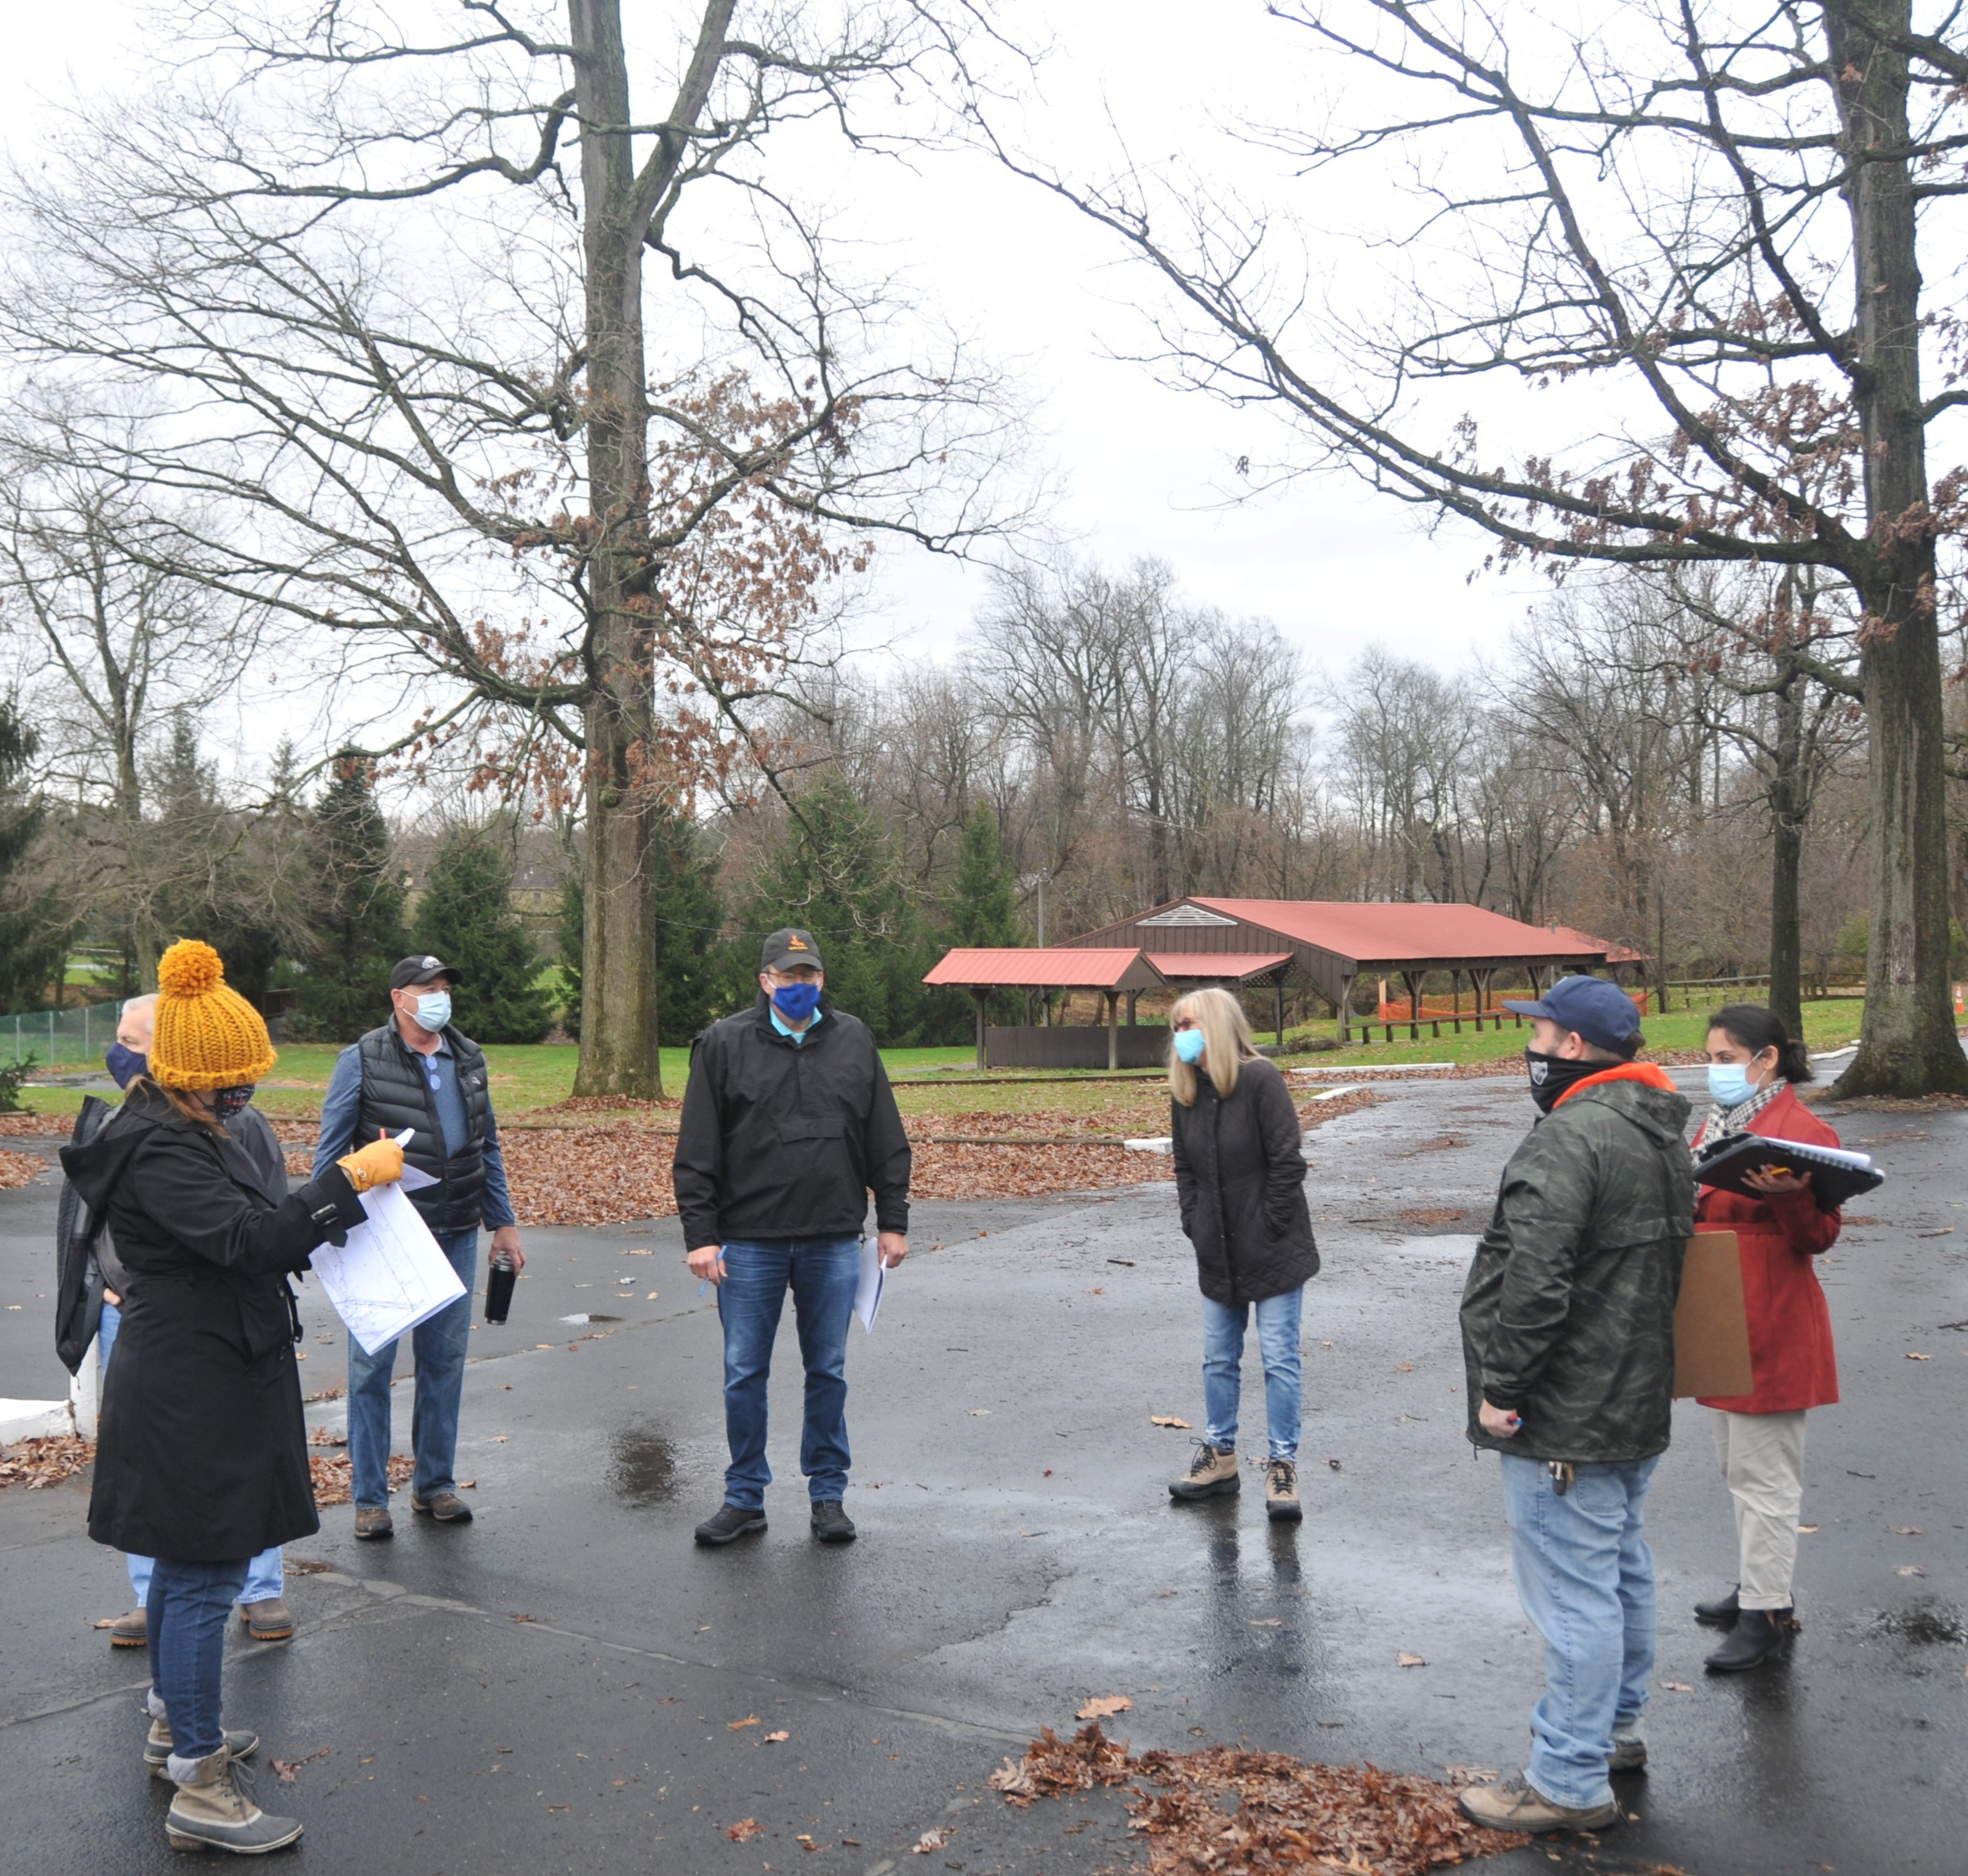
Consultant Team
Simone Collins Landscape Architecture
Peter Simone / Sarah Leeper / Joe Wallace
4ward Planning
Todd Poole
Princeton Hydro
Laura Craig
Spotts, Stevens, & McCoy
Mark Stabolepszy / Lyn Rodino
Wallover Architects
Ted Wallover / Susan Wallover
Seiler + Drury Architecture
Doug Seiler / Eric Baugher
Comprehensive Land Service
Patrick Fasano
Environmental Standards
Joe Kraycik / Stephen Brower
Notes:
Pete

Slide 6

Master Plan Process
What is a Master Plan?
* WE ARE HERE *
Phase 1 Phase 2 Phase 3
Notes:
Sarah

Slide 7
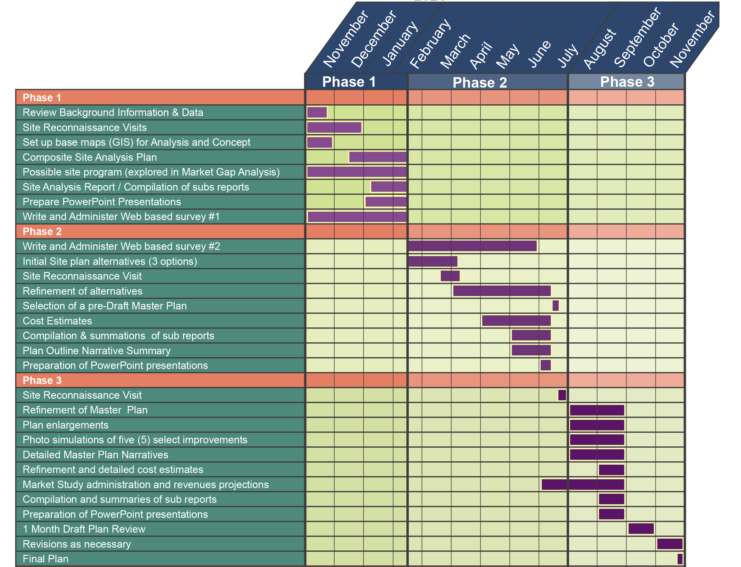
Project Schedule
Notes:
Sarah

Slide 8
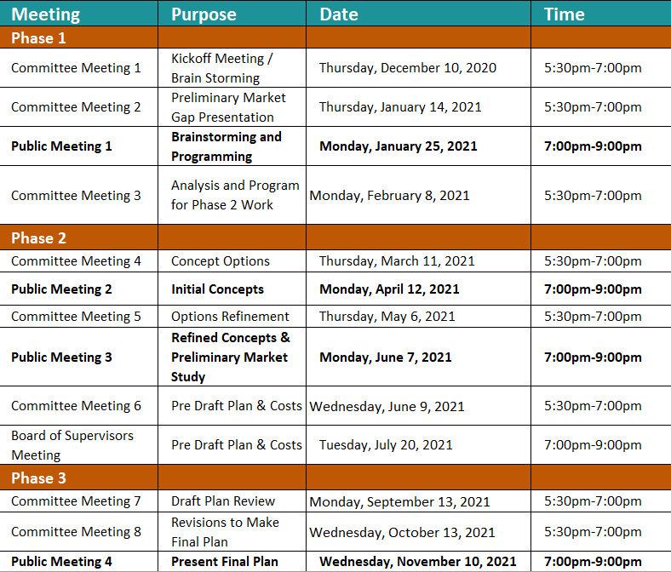
Project Schedule
6:00pm-8:00pm
Notes:
Sarah

Slide 9
Project Scope
PHASE 1 (NOV-FEB)
PHASE 2 (FEB-AUG)
PHASE 3 (AUG-NOV)
PRIMARY TASKS: [INVENTORY & ANALYSIS] The primary tasks of this phase will include an inventory of existing conditions, market study, programming and initial conceptualization of potential future uses.
Swimming Pool(s)
Mechanical
Electrical
Plumbing
Structural
Filtration System
Accessibility Requirements
Environmental Issues
Flood Plain
Drainage System
Existing Buildings
Structural
Accessibility
Electrical
Plumbing
Sewer
Existing Site Features
Golf Course
Pavilions
Playing Fields
Courts
Trails
Ponds
Creek
Rest Rooms
Environmental Study
Wetlands
Flood Plain
Meadows
Trees/Tree Canopy
Wildlife
Soil Types
Permitting Requirements
General Conditions
Property Electrical Service
Potable Water Supply
Sewer System
Storm Water Facilities
Dam Condition
Utility Line/Utility Easements
Accessibility
Parking
Facility Access
Trails
Connectivity to other township trails/parks
Meetings
3 Committee
1 Public
Market Study
Notes:
Sarah

Slide 10
Project Scope
PHASE 1 (NOV-FEB)
PHASE 2 (FEB-AUG)
PHASE 3 (AUG-NOV)
PRIMARY TASKS: [DEVELOP CONCEPTS] Building on the insights gained in Phase 1, the possible future use concepts will be developed into one (1) focused development option. Phase 2 elements will include:
Establish goals and objectives for activities and facilities
Resident survey within context of Market Analysis
Progressive development of site plan concept options and refinements
Adaptive reuse options for existing site infrastructure
New facilities and new infrastructure / access / parking
Site and environmental enhancements
Committee and public input, suggestions and comments
Plan recommendations & costs estimates to the Board of Supervisors
Meetings
3 Committee
2 Public
1 Board of Supervisors
Notes:
Sarah

Slide 11
Project Scope
PHASE 1 (NOV-FEB)
PHASE 2 (FEB-AUG)
PHASE 3 (AUG-NOV)
PRIMARY TASKS: [DEVELOP MASTER PLAN] Develop a detailed master site plan.
Detailed master plan / plan enlargements
Possible second resident survey (TBD)
Adaptive reuse plans for existing facilities
Refined cost estimates
Economic pro forma for up to 4 activities / facilities
Site and environmental enhancements / management guidance
Photo-simulations for 5 select improvements
Final report
Meetings
2 Committee
1 Public
Notes:
Sarah

Slide 12
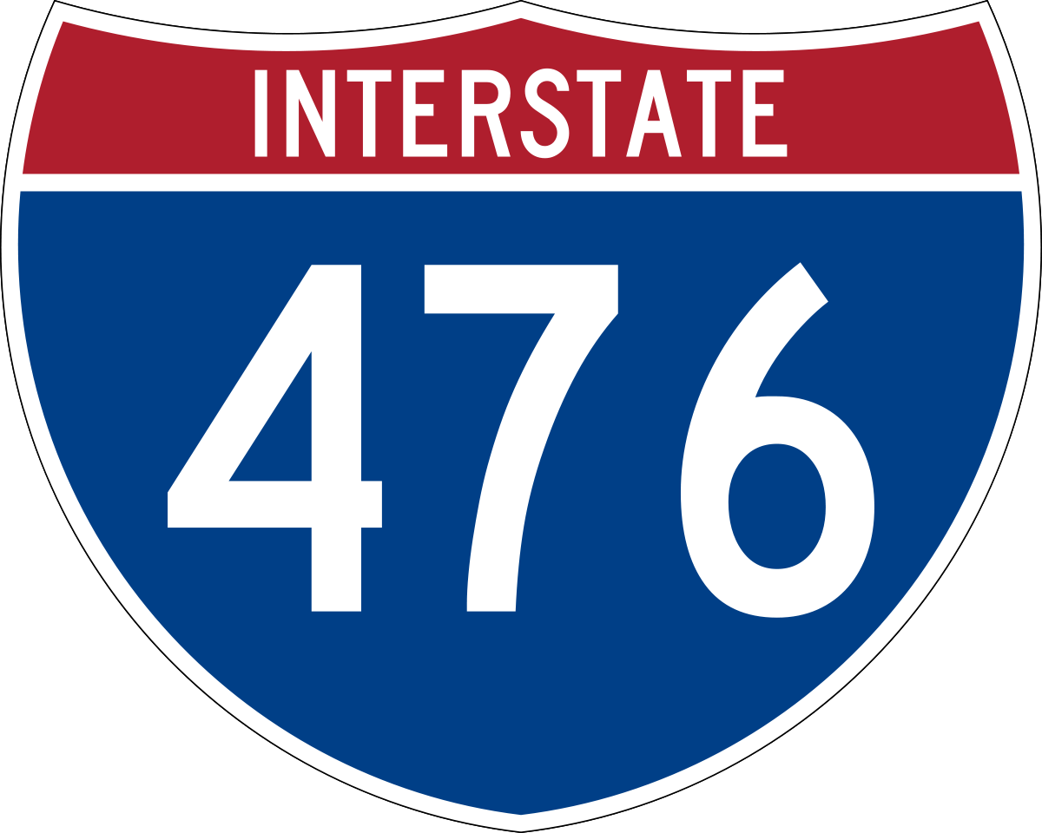
E. Township Line Road
Site Overview
Arch Street Road
Jolly Road
Notes:
Joe

Slide 13
E. Township Line Road
8.8 Acres
Site Overview
72.3 Acres Total
47.5 Acres
Arch Street Road
Jolly Road
12.5 Acres
3.5 Acres
Notes:
Joe

Slide 14
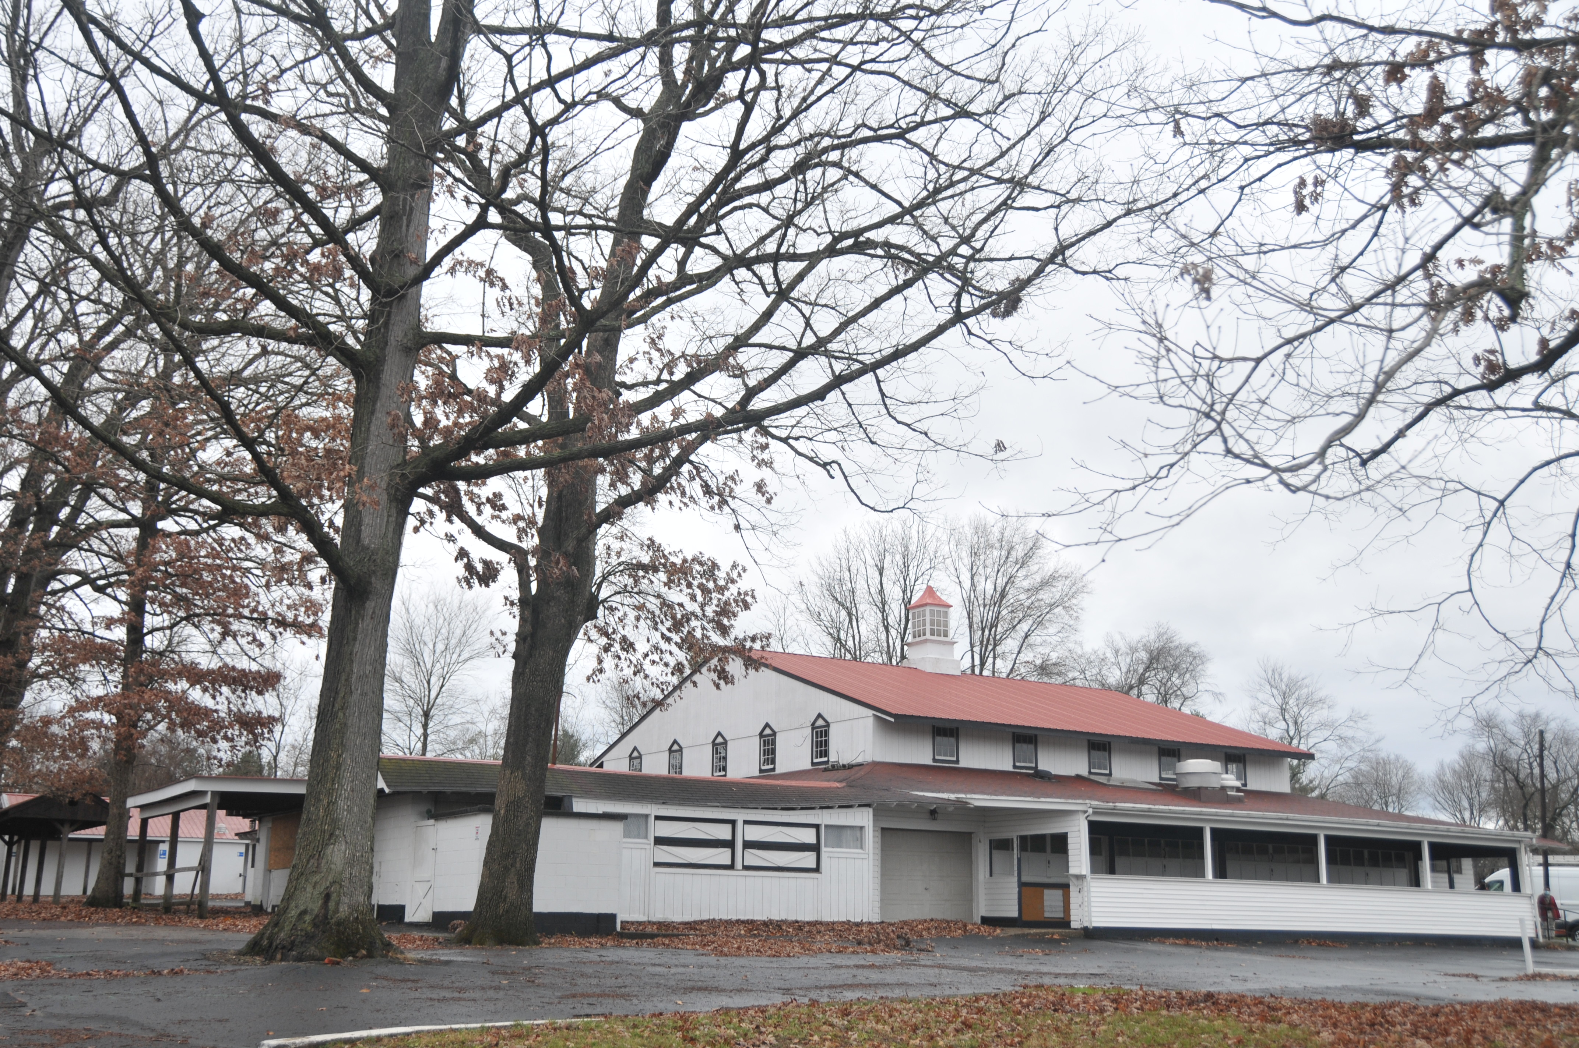
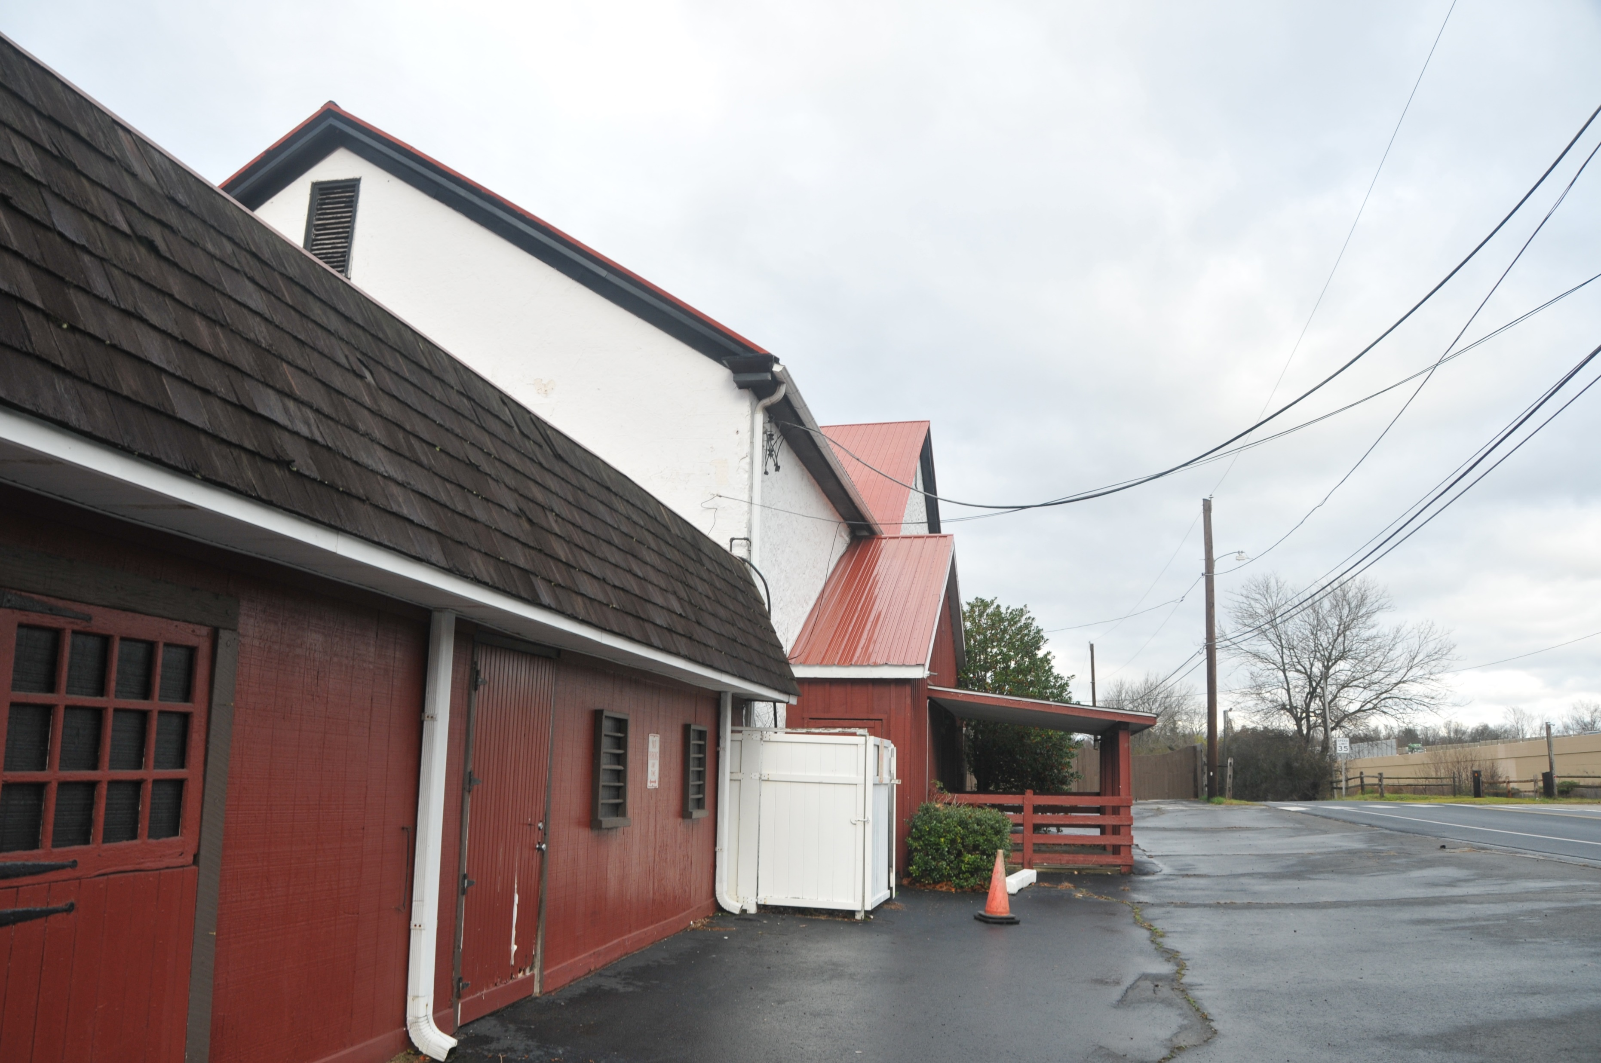
Site Overview
Existing Buildings & Structures
Notes:
Joe

Slide 15
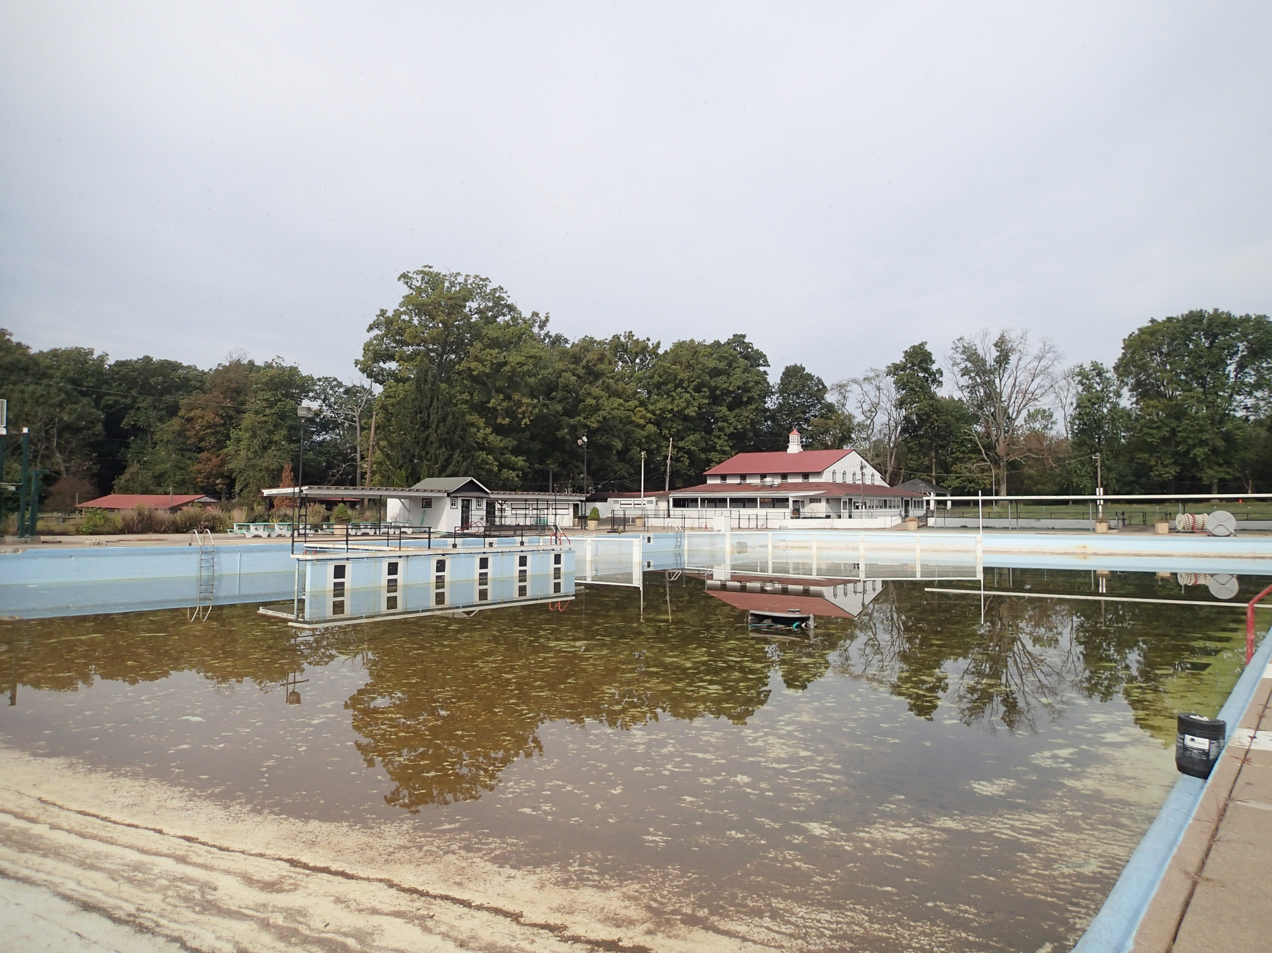
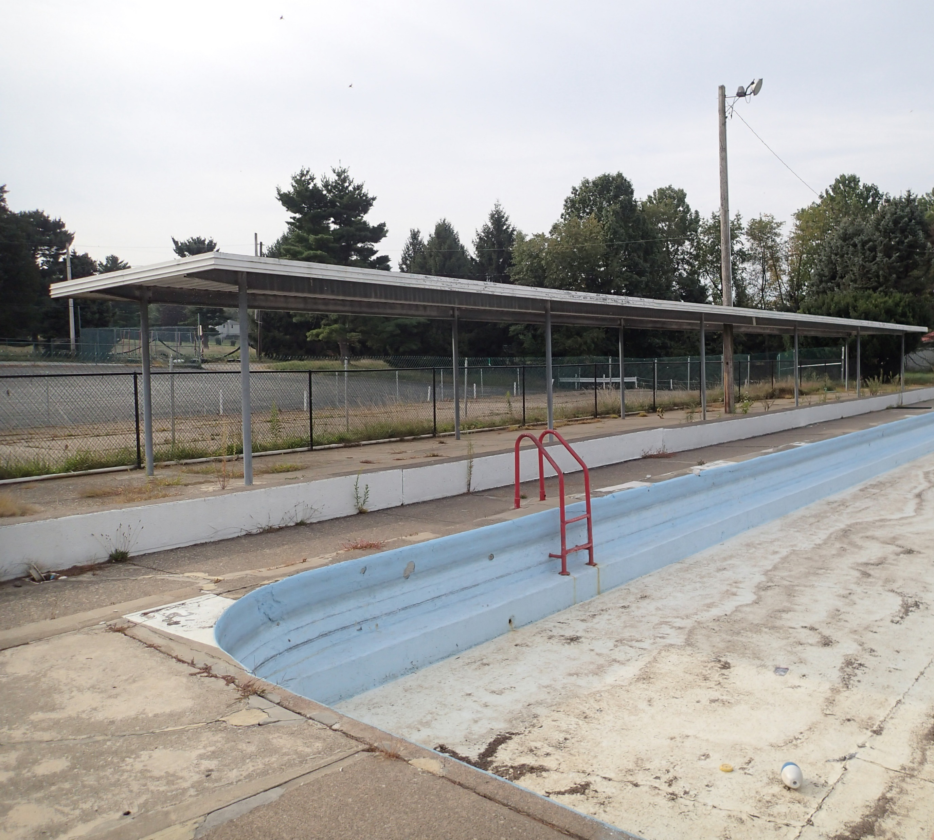
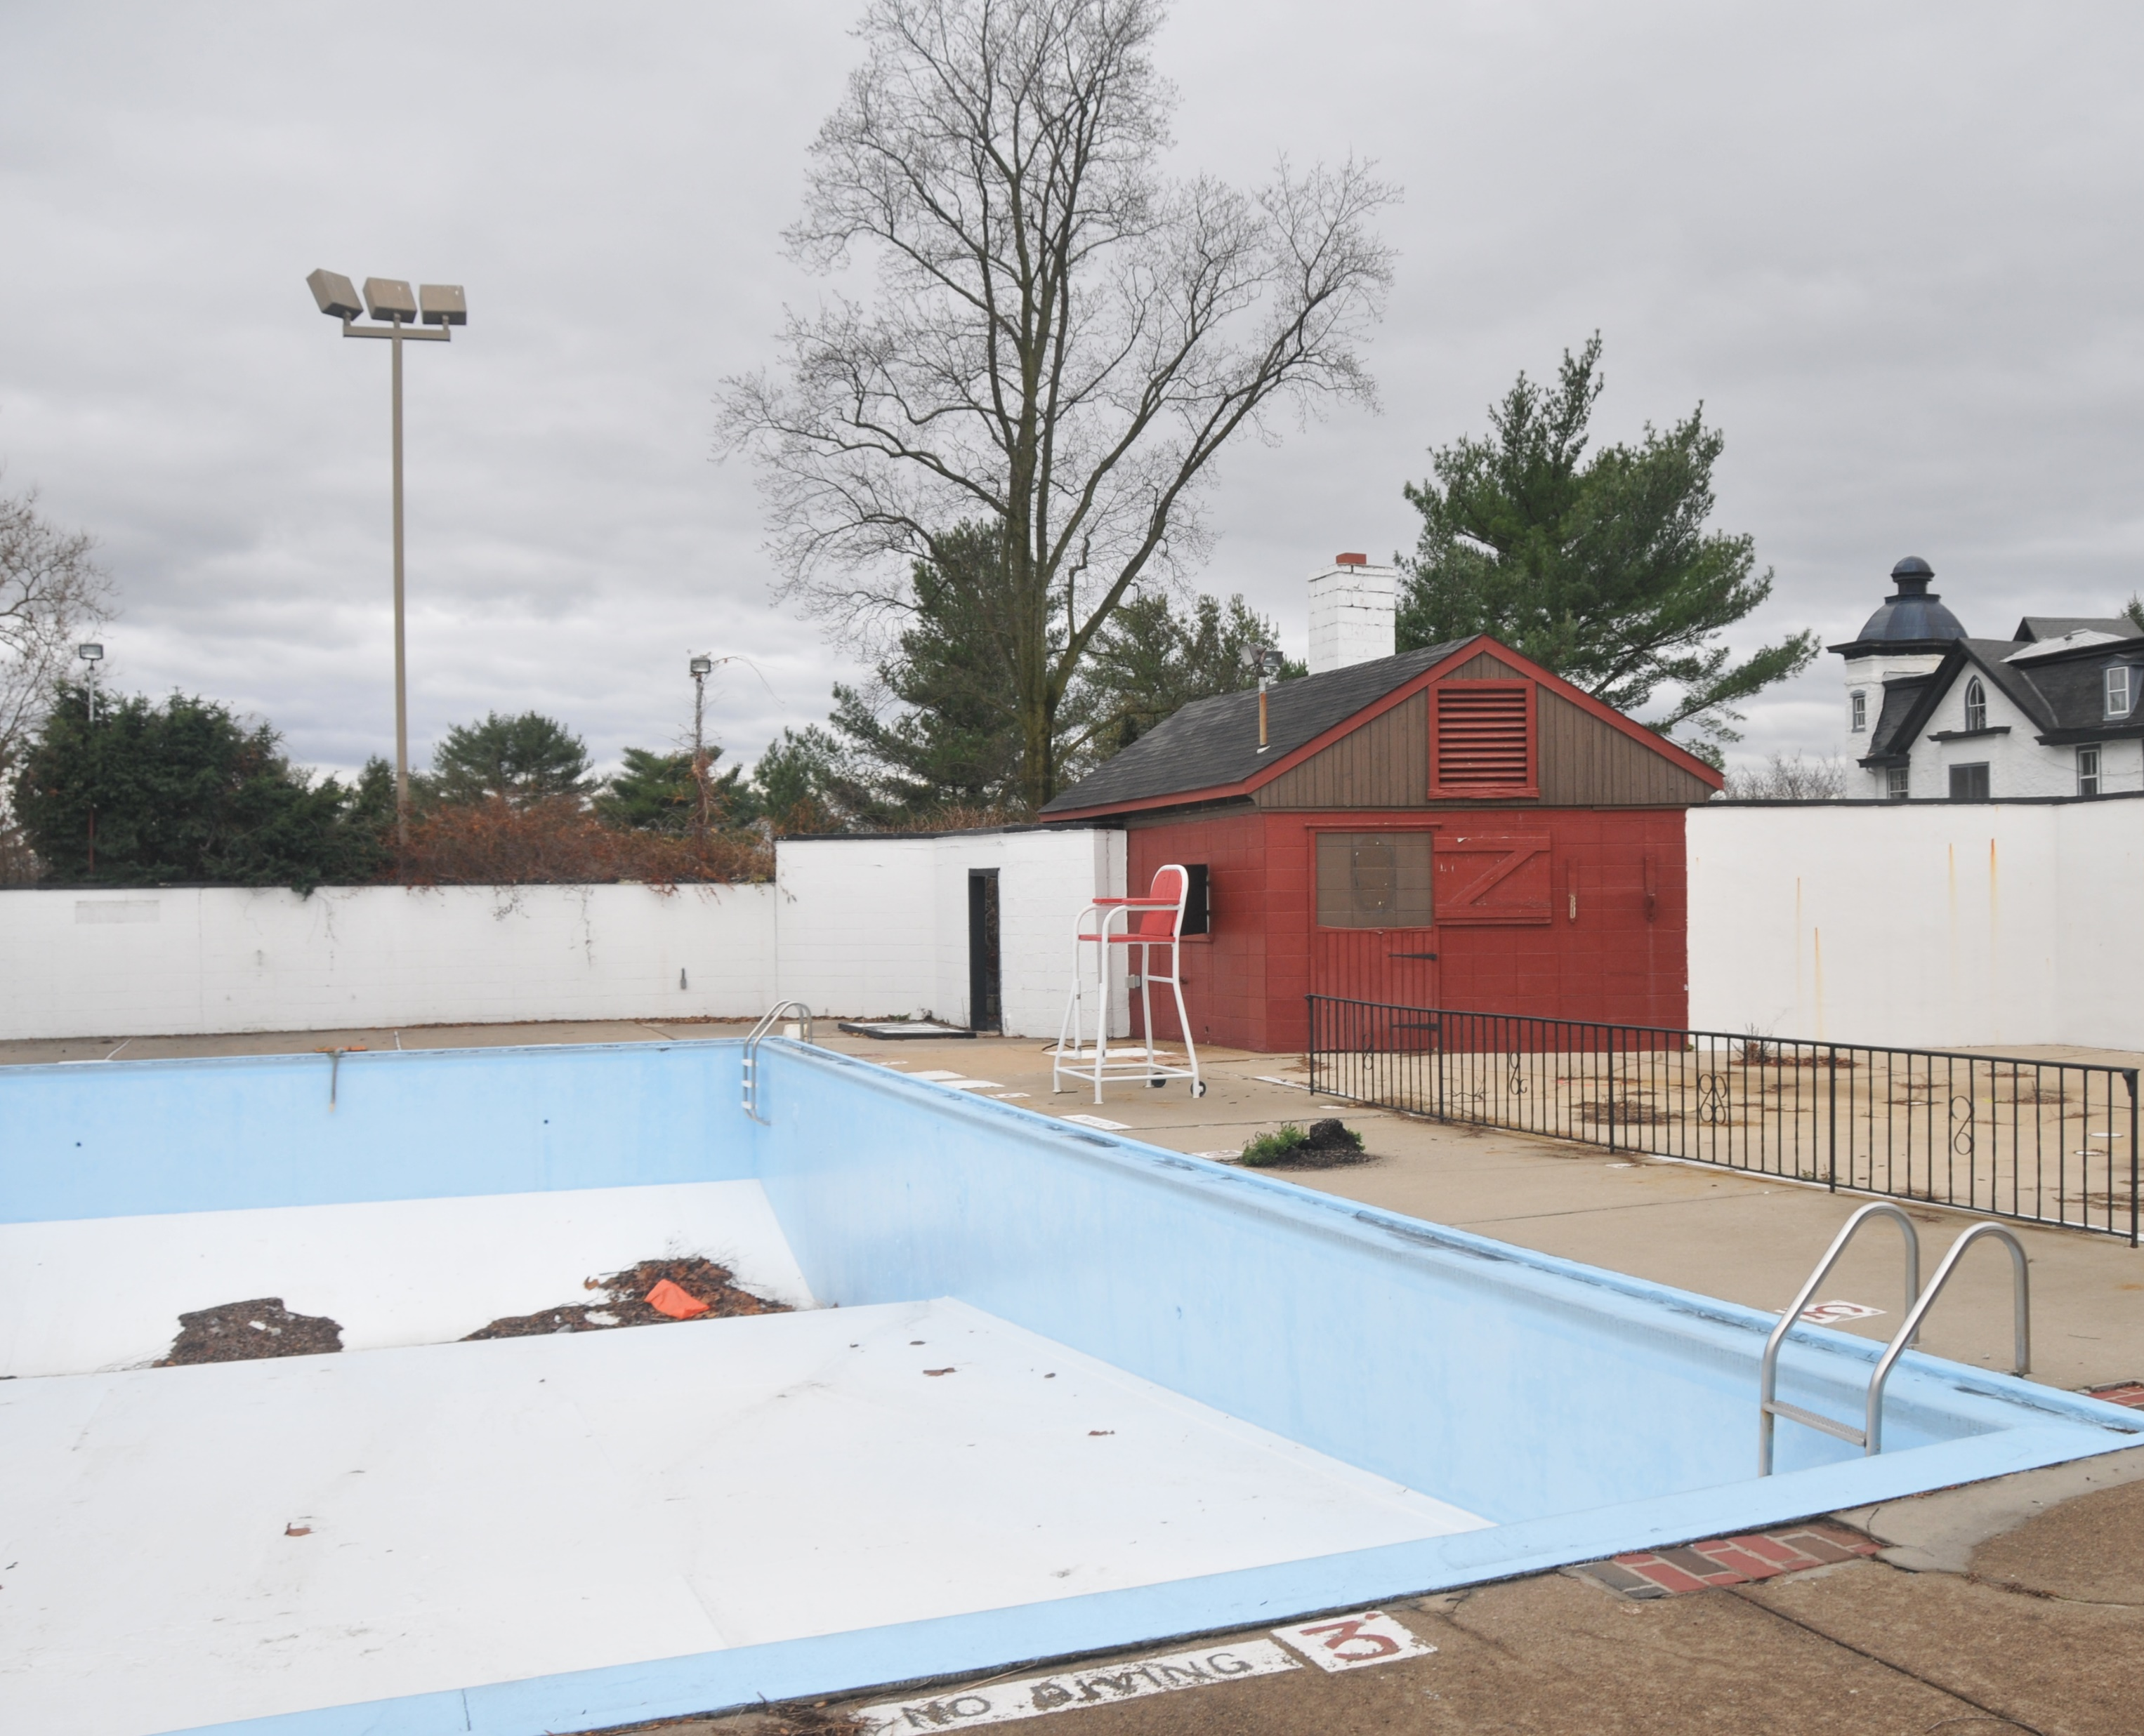
Site Overview
Existing Buildings & Structures
Notes:
Joe

Slide 16
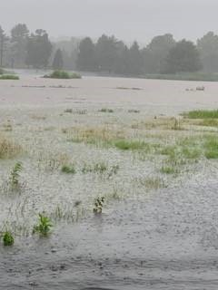
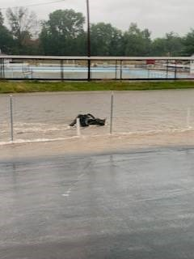
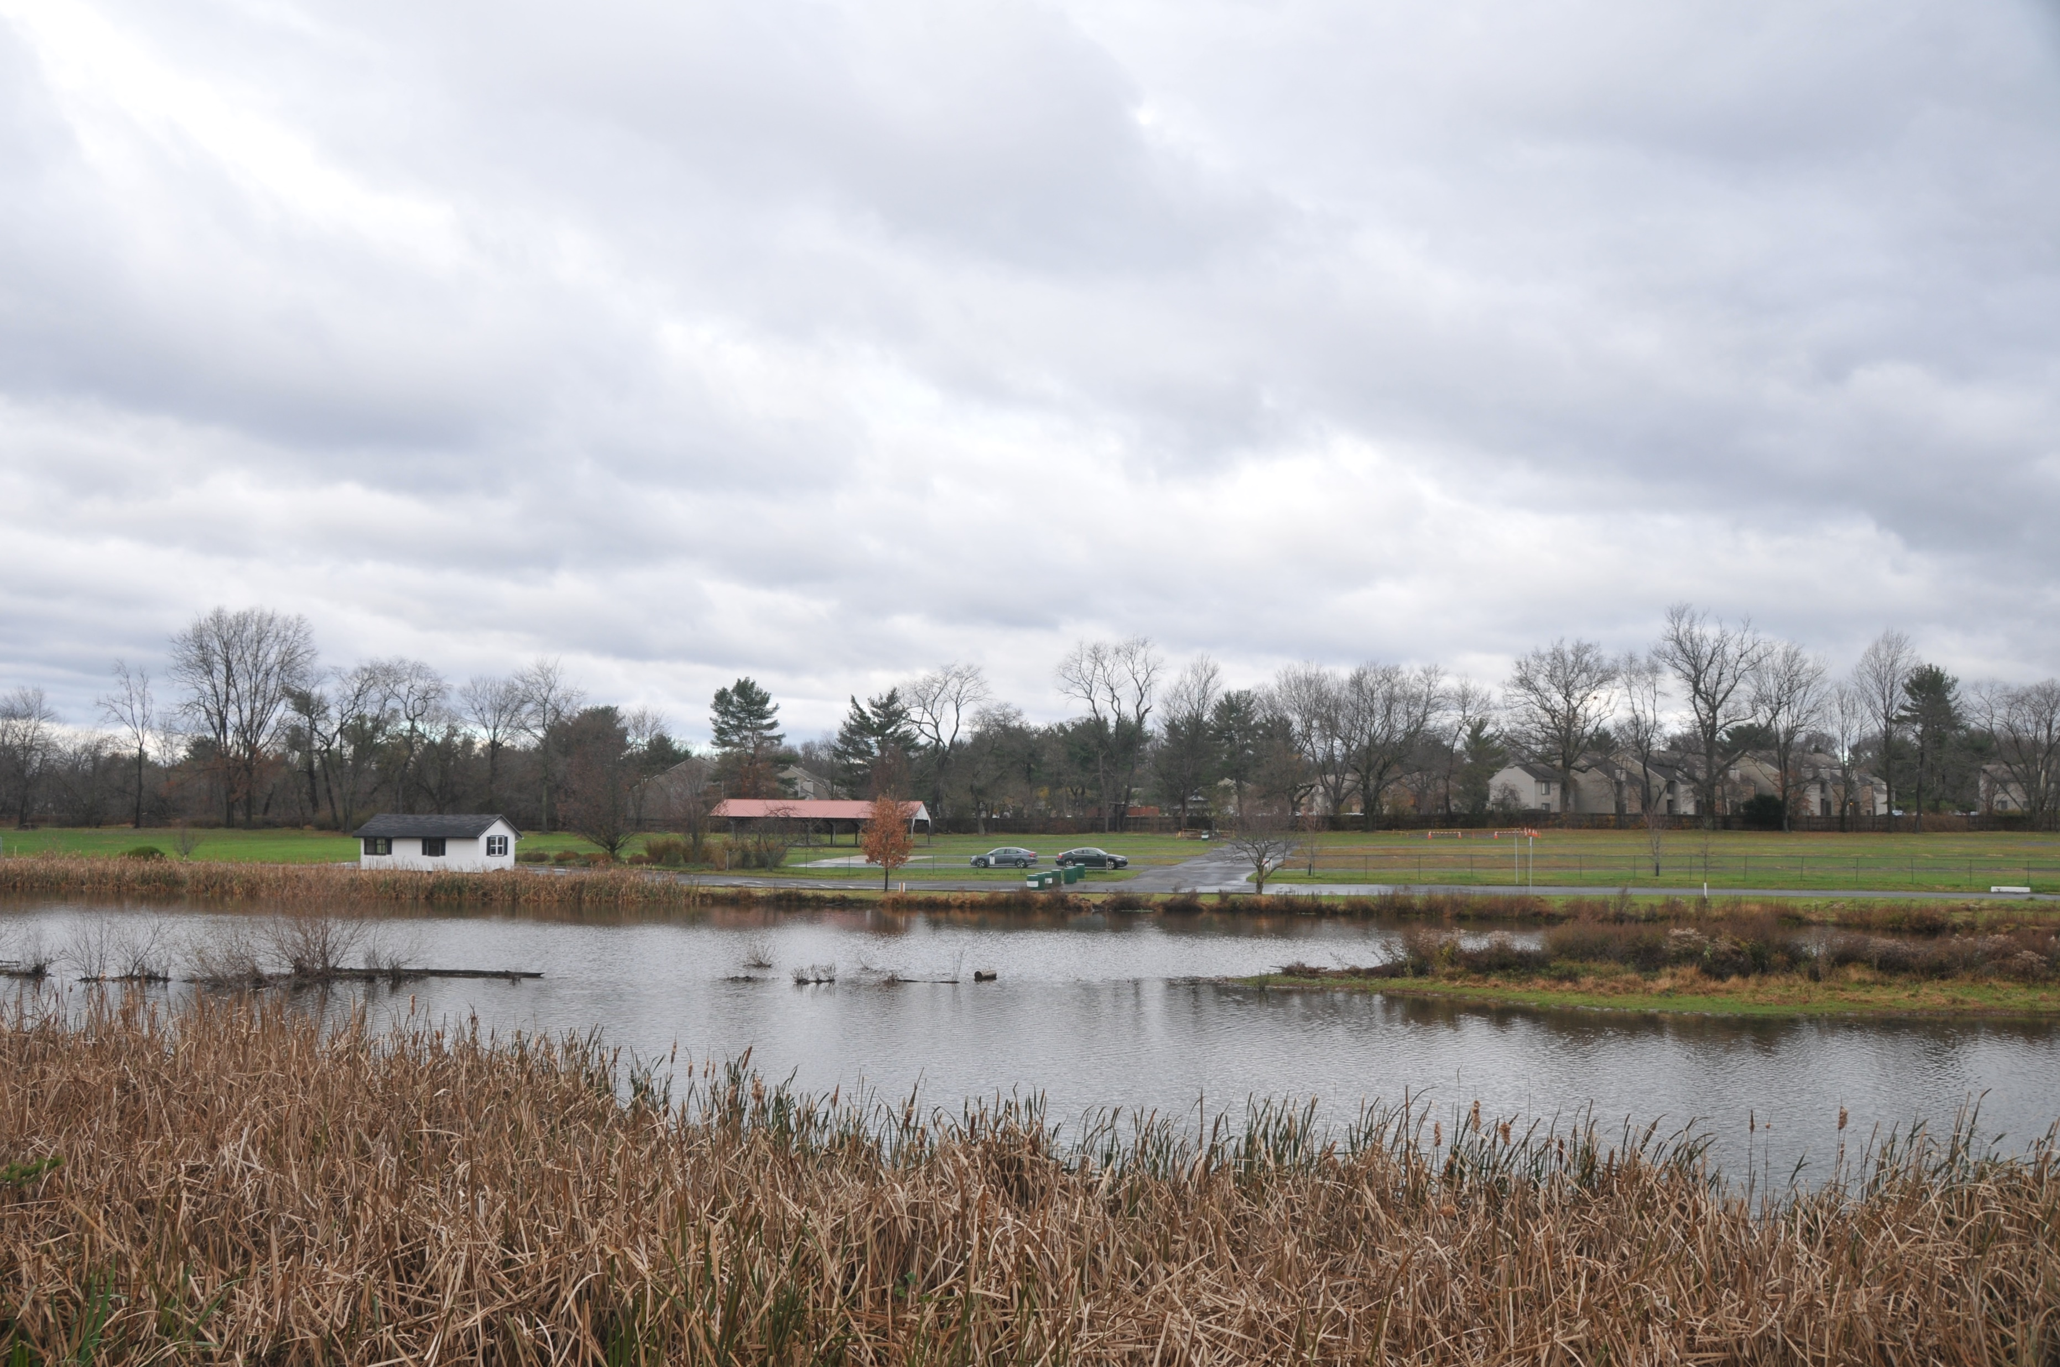
Site Overview
Hydrology
Notes:
Joe

Slide 17
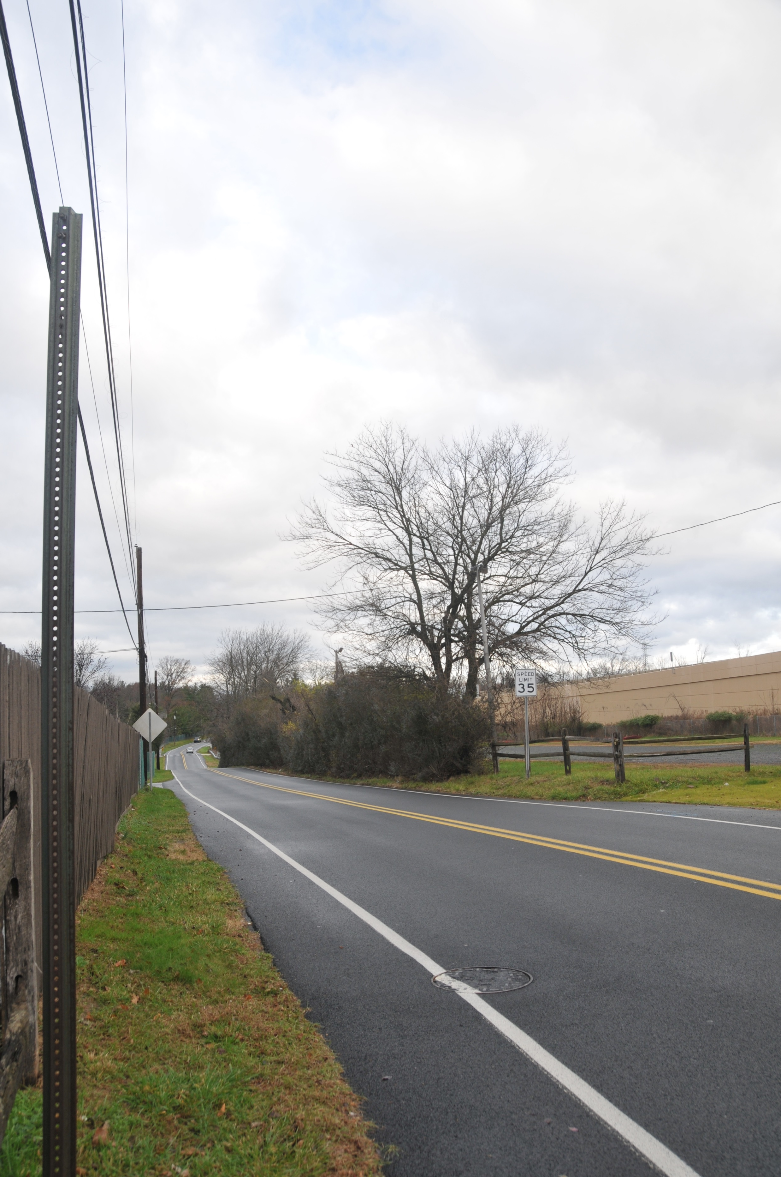
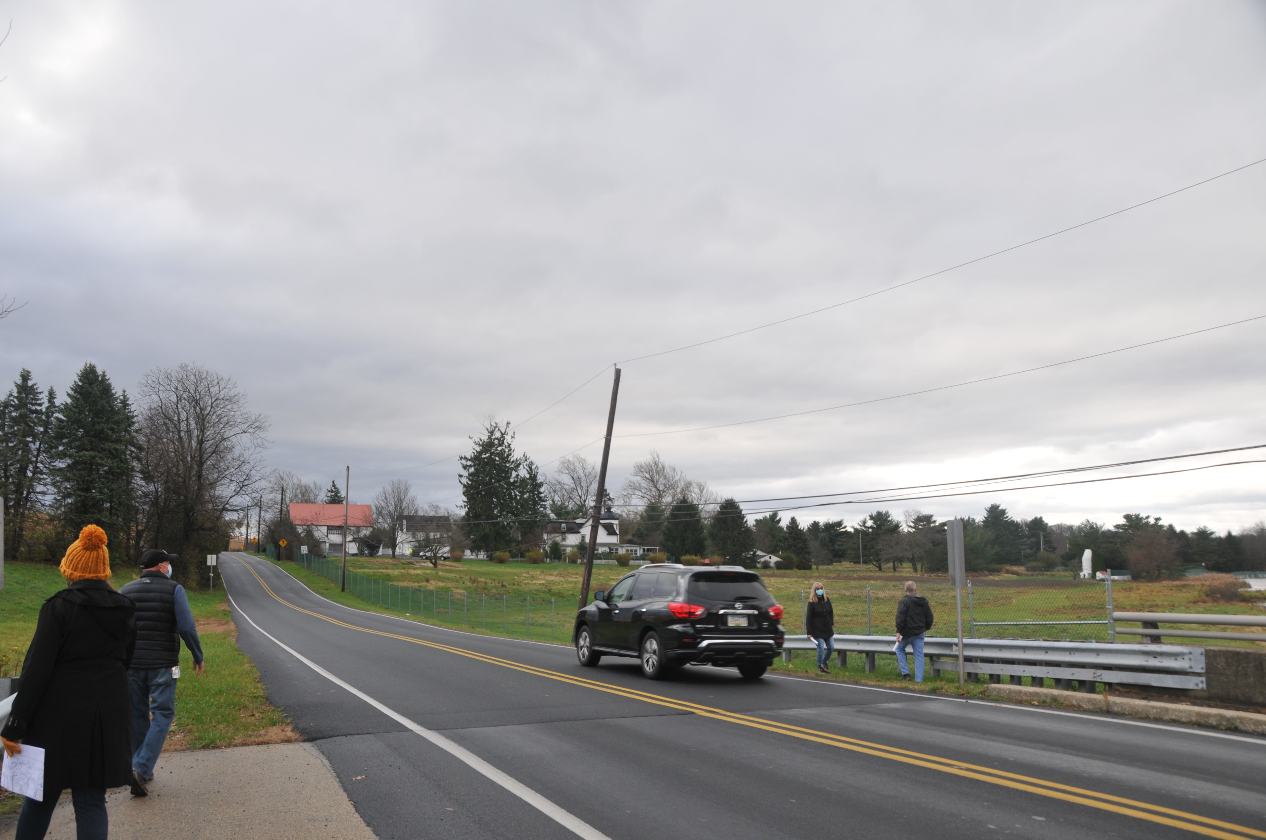
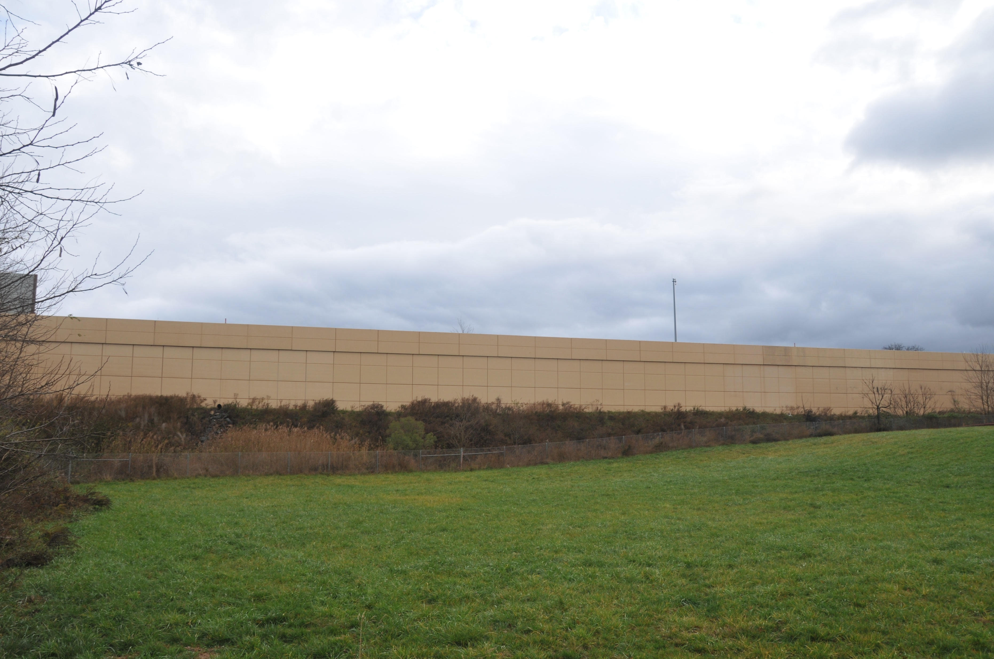
Site Overview
Arch Street Road
Vehicular, Traffic & Parking
Jolly Road
Entrances:
Notes:
Joe

Slide 18
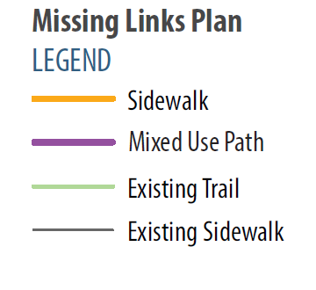
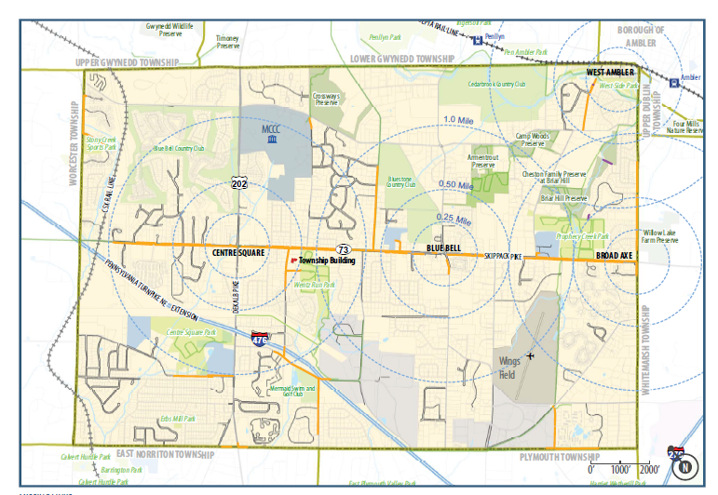
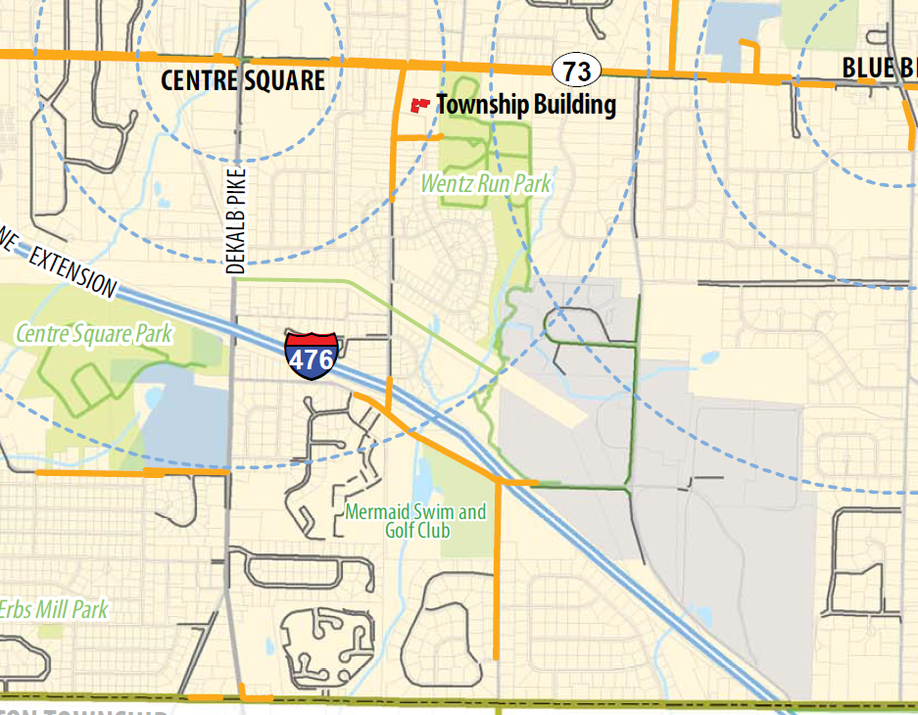
Site Overview
Multi-Modal
2019 Whitpain Twp Walkability Study
Project
Area
Notes:
Joe

Slide 19
Preliminary Market Analysis Findings
Market Study Overview
Socio-Economic Trends
Competitive Supply
Market Study Takeaways
Notes:
Todd

Slide 20
Market Study Overview
Notes:
Todd

Slide 21
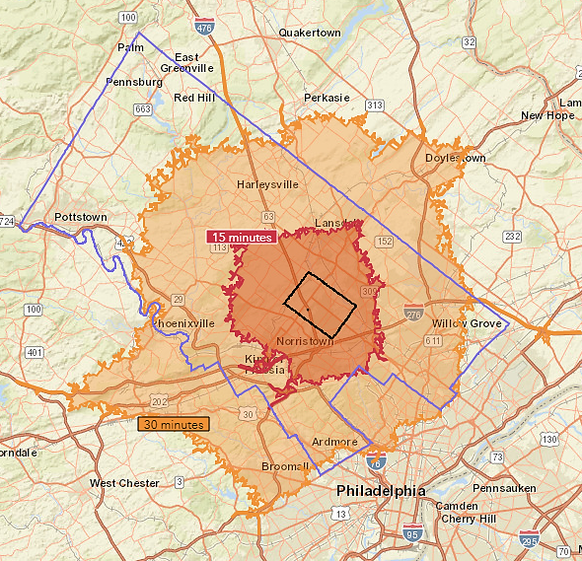
Background: Study Areas
Whitpain Township: As defined by Township boundaries
15-Minute PMA: The primary market area (PMA) is defined as a 15-minute drive-time contour from the center of the park (an approximate six-mile radius).
30-Minute SMA: The secondary market area (SMA) is defined as a 30-minute drive-time contour from the center of the park (an approximate 15-mile radius).
Montgomery County: As defined by county boundaries
Montgomery County
15-Minute PMA
Mermaid Lake→
Whitpain Township
30-minute SMA
Source: Esri; 4ward Planning Inc., 2020
Market Study Overview Socio-Economic Trends Competitive Supply Market Study Takeaways
Notes:
Research continued to confirm that the making of an outdoor participant began with convenient, close-to-home outdoor recreation opportunities. Most
participants, 63.3 percent, traveled only ten miles from their homes to their outdoor activities. A much smaller 18.9 percent of participants ventured 25 miles
or more to their destinations.

Slide 22
Socio-Economic Trends

Slide 23
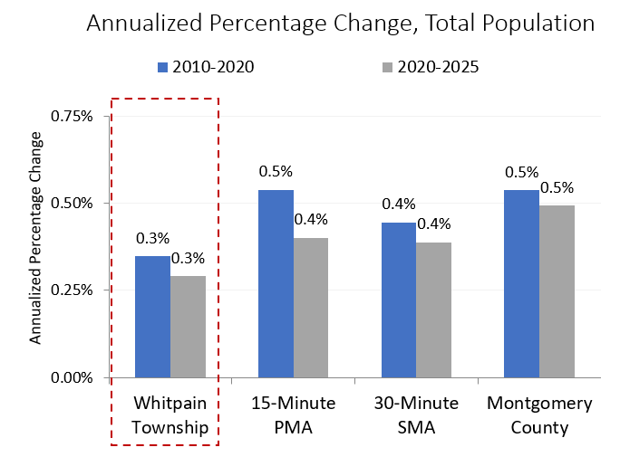
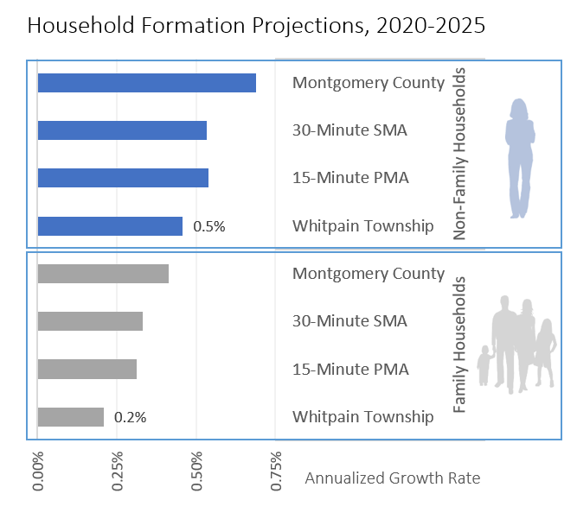
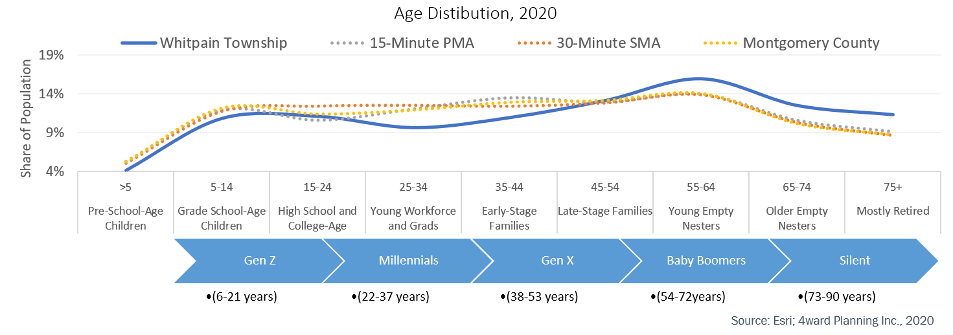
Total Population
Population change is projected to be flat, locally and regionally.
Household Formation
Household formation, like population, is projected to
be flat through 2025, with family households experiencing the least growth
Age Metrics
Age distribution, locally and regionally, skews older
Source: US Census Bureau; Esri; 4ward Planning Inc., 2020
Market Study Overview Socio-Economic Trends Competitive Supply Market Study Takeaways

Slide 24
Competitive Supply

Slide 25
Key Findings: Golf Courses
Golf courses abound in the 15-minute PMA
There are 12 golf courses in the 15-minute PMA, including ten 18-hole golf courses and two nine-hole golf courses. Nine are private or semi-private and three are public. None of these golf courses appear to offer pitch and putt (18-hole courses with a length typically under 1,310 yards).
Driving Distance (Miles) | Name | Course Type | City | Holes | Par | Length (Yards) | Type
1.9 | Bluestone Country Club | Golf | Blue Bell | 18 | 71 | 6,023 | Private
2.6 | The 1912 Club | Golf | Plymouth Meeting | 18 | 72 | 6,575 | Private
3.3 | Cedarbrook Country Club | Golf | Blue Bell | 18 | 72 | 6,873 | Semi-Private
4.5 | Sunnybrook Golf Club | Golf | Plymouth Meeting | 18 | 72 | 6,823 | Private
6.3 | Whitemarsh Valley Club | Golf | Plymouth Meeting | 18 | 72 | 6,629 | Private
6.8 | Old York Road Club | Golf | Blue Bell | 18 | 71 | 6,558 | Private
6.9 | Jefferson Golf Course | Golf | Norristown | 18 | 70 | 6,443 | Public
7.4 | Gulph Mills Golf Club | Golf | King of Prussia | 18 | 71 | 6,289 | Private
7.4 | Worcester Golf Club | Golf | East Norriton | 9 | 35 | 3,047 | Public
7.6 | Skippack Golf Club | Golf | Skippack | 18 | 70 | 6,007 | Public
9.8 | Flourtown Country Club | Golf | Flourtown | 9 | 35 | 2,884 | Private
11.8 | Sandy Run Country Club | Golf | Ambler | 18 | 72 | 6,525 | Private
Market Study Overview Socio-Economic Trends Competitive Supply Market Study Takeaways

Slide 26
Swimming Pools: 15-Minute PMA
Half of all parcels in the Township already served by a pool
According to GIS data from Montgomery County, 51 percent of all parcels in Whitpain Township are served by a private community pool or a pool on an individual private lot.
There are at least 10 large swimming pools in the 15-minute PMA (an approximately six-mile radius), with five providing public access and two located outdoors.
Radius Distance (Miles) | Facility | Town | Type | Public Access | Pricing
1.5 | LA Fitness - East Norriton/Swede Square | East Norriton | Indoor | Yes | Drop-in: $15
1.5 | Greater Plymouth Community Center | Plymouth Meeting | Indoor | Yes | Drop-in: $10-$14 for residents/non
2.1 | Blue Bell Country Club | Whitpain Township | Outdoor | No
3.4 | Wissahocken High School Natatorium | Ambler | Indoor | Yes | Free community swim (Wednesdays)
3.4 | Plymouth Whitemarsh High School Swimming Pool | Lafayette Hill | Indoor | No
4.0 | Germantown Academy | Fort Washington | Indoor | No
4.8 | Upper Dublin Community Pool | Fort Washington | Outdoor | Yes | Adults: $2-$6 weekdays, $4-$8 weekends
5.0 | Life Time Fitness - Fort Washington | Fort Washington | Indoor | Yes | Drop-in: $35
5.1 | Ambler YMCA | Ambler | Indoor | No
5.9 | Upper Merion Area Middle & High School Pool | King of Prussia | Indoor | No
Sources: Montgomery County; Swimmers Guide; 4ward Planning, 2020
Market Study Overview Socio-Economic Trends Competitive Supply Market Study Takeaways

Slide 27
Key Findings: Splash Pads
Eight suburban area splash pads within a 30-minute drive
Alverthorpe Park in Abington Township features a lake, wading pool, Par-3 golf course, as well as other recreation and open space amenities.
The park offers both year-round (Par-3 golf, tennis courts, basketball courts, playground, and fishing) and summer activities (mini golf, wading pool, camping), as well as various rental facilities (picnic shelter and tables, pre-school pavilion, min-golf pavilion).
Driving Distance (Miles) | Name | Town | Description
7.9 | Montgomery Twp. Community & Rec. Center | Montgomeryville | Shade sail section with smaller sprinklers for younger children and a section with larger sprinklers for older children
10.3 | Everybody's Playground | Horsham | Located within Lukens Park, playground has a spray station for hot summer days
13.3 | Freedom Playground at Haverford Reserve | Haverford | The water misters at Freedom Playground
13.6 | Alverthorpe Park | Jenkintown | The site has a lake, wading pool, a Par 3 golf course, as well as various other recreation and open-space amenities.
14.2 | Masons Mill Park | Huntingdon Valley | This 76-acre park also provides a fun water spray pole.
15.7 | Warwick Community Park | Jamison | Spray pole at this Warwick Township park
Market Study Overview Socio-Economic Trends Competitive Supply Market Study Takeaways

Slide 28
Key Findings: Skating Rinks
Seven skating rinks in 30-minute SMA
While there are no skating rinks in the 15-minute PMA, there are seven skating rinks in the 30-minute SMA (all indoor ice-skating rinks). Most facilities offer public and member access, lessons, and event space for birthday parties.
Located just outside the 15-minute PMA, the Wissahickon Skating Club is the closest facility to Mermaid Lake. Operating as a private, not-for-profit, this family-oriented indoor skating club offers both member and public sessions for ice skating and hockey (both senior and youth) and two birthday party rooms ($100-$150 flat fees).
Driving Distance (Miles) | Business Name | Town | Skating Rink Type | Type | Pricing
9.6 | Wissahickon Skating Club | Philadelphia | Ice | Indoor | Admission: $7 Skate rental: $3
10.8 | Oaks Center Ice Hockey Rink | Oaks | Ice | Indoor | Admission: $7 Skate rental: $3
11 | Hatfield Ice World | Colmar | Ice | Indoor | Admission: $10, Skate rental: $3
12 | Wintersport Ice Sports Arena | Willow Grove | Ice | Indoor | $10 Admission & includes skate rentals
12 | In Line 309 | Hatfield | Roller | Indoor | $12 Admission & includes skate rentals
12.1 | Philadelphia Skating Club | Ardmore | Ice | Indoor | Admission: $10, Skate rental: $5
13.9 | Bucks County Ice Sports Ctr | Warminster | Ice | Indoor | Admission: $15
Market Study Overview Socio-Economic Trends Competitive Supply Market Study Takeaways

Slide 29
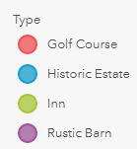
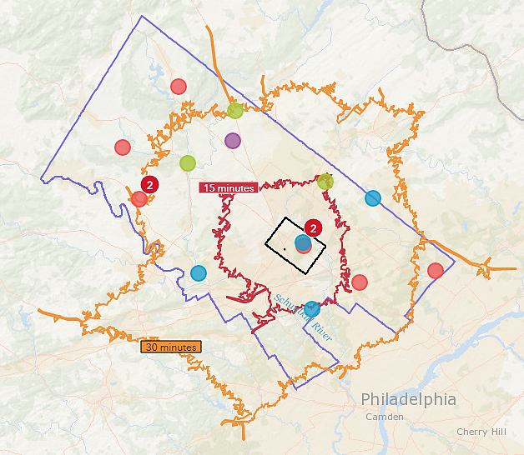
Key Findings: Outdoor Wedding Venues
Three existing large outdoor wedding venues in the Township
The Manor House at Prophecy Creek Park
The Country House at Bluestone Country Club,
The Normandy Farm Hotel & Conference Center
Each have the capacity to accommodate approximately 300 guests.
According to interviews with local event planners, Montgomery County will likely see increased demand for unique small- to mid-size private party space in authentic, natural settings.
Venues that include adjacent recreational opportunities (e.g., park space) will likely be particularly appealing.
Market Study Overview Socio-Economic Trends Competitive Supply Market Study Takeaways

Slide 30
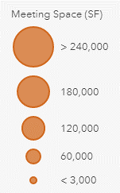
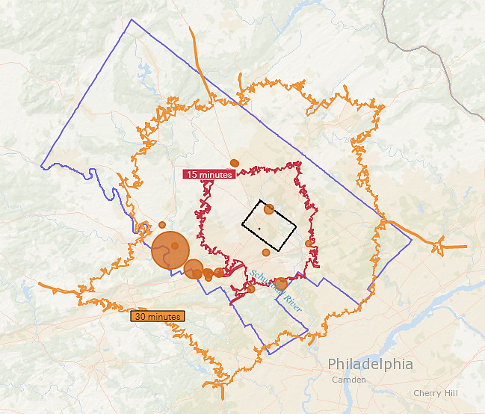
Key Findings: Conference Centers & Meeting Venues
The area is, generally, well served by conference centers
Montgomery County features more than 80 hotels, 300 meeting venues and approximately one-million square feet of meeting space
The 30,000-square-foot Normandy Farm Hotel and Conference Center is the closest large meeting space venue (located just two miles north of Mermaid Lake in Whitpain Township).
However, the existing caretaker’s house could offer a unique, small retreat experience for those looking for something less corporate and without the need for lodging.
Normandy Farm Hotel And Conference Center
Market Study Overview Socio-Economic Trends Competitive Supply Market Study Takeaways

Slide 31
Key Findings: Sports Centers
Three sports centers within the 15-minute PMA
These include a membership-based multi-sports center (The Proving Grounds) and two public school sports centers (Colonial School District and Germantown Academy).
There are seven sports centers (both indoor and outdoor) within the larger 30-minute SMA
There may not be enough indoor facilities to meet local demand from adult and youth sports communities; consequently, Mermaid Lake may be an ideal location for an indoor multi-sports facility.
Driving Distance (Miles) | Name | Town | Square Feet | Facility | Type | Focus
5.1 | Colonial School District | Plymouth Meeting | NA | Public School | Outdoor | Multi-Sports
5.3 | The Proving Grounds | Conshohocken | NA | Sports Center | Outdoor* | Multi-Sports
6.0 | Germantown Academy | Fort Washington | NA | Private School | Outdoor | Multi-Sports
6.9 | Competitive Edge Sports | King of Prussia | 60,000 | Sports Center | Indoor | Basketball/Volleyball
7.4 | Temple Univ. Ambler Sports Complex | Ambler | NA | Private School | Outdoor | Baseball/ Softball/ Soccer
11.7 | Villanova University Athletics | Villanova | NA | Private School | Outdoor | Multi-Sports
12.0 | All Sports Center | Upper Providence | 49,441 | Sports Center | Indoor | Multi-Sports
12.9 | Sofive Elkins Park | Elkins Park | NA | Sports Center | Both | Soccer
13.0 | XL Sports World | Hatfield | 78,000 | Sports Center | Indoor | Multi-Sports
13.1 | YSC Sports | Wayne | 120,000 | Sports Center | Both | Soccer
Market Study Overview Socio-Economic Trends Competitive Supply Market Study Takeaways

Slide 32
Market Study Takeaways

Slide 33
Study Takeaways: Project Takeaways
Park programming for aging baby boomers
Baby boomers (those born between 1946 and 1964) currently represent a relatively high share of Whitpain Township’s population…and are expected to experience the strongest near-term population growth.
Young adults and early-stage families
Through 2025, the Township is also expected to experience some population growth among those ages 25 to 34 (representing young workforce and recent college graduates) and 40 to 44 (representing early-stage families).
Relatively high incomes and favorable spending
The median household income in Whitpain Township ($135,150) is relatively high compared to household incomes in the PMA and SMA ($87,600 and $85,010, respectively)
A mini-golf and pitch and putt golf course
While there is an ample supply of traditional golf courses in the region, accommodating a different golf format at Mermaid Lake could appeal to a new market.
Outdoor Swimming Pool Center
While there are at least 10 large swimming pools in the PMA, just half offer public access and only two are located outdoors. According to interviews, there is likely unmet demand for a daily pay pool option for residents.
Market Study Overview Socio-Economic Trends Competitive Supply Market Study Takeaways

Slide 34
Study Takeaways: Project Takeaways
Playground & splashpad
With the closet splash pad located eight miles away, there is likely unmet local demand among local area families with young children.
Outdoor skating facility
While there are seven indoor skating rinks in the SMA, there are no outdoor skating options. An outdoor skating space at Mermaid Lake could also provide a strong revenue-generating opportunity.
Small- to mid-size event space:
According to interviews with local event planners, Montgomery County will likely see increased demand for unique small- to mid-size private party space in authentic, natural settings, particularly in the aftermath of the Covid-19 pandemic, as many clients have delayed celebrations and will be seeking venues just beyond large urban areas.
Outdoor wellness space
As a result of Covid-19 pandemic, spending time in outdoor spaces has become essential for many. People are rediscovering an appreciation for the solace and stress-reduction found outdoors. An outdoor space offering art and natural features fostering wellness will likely have broad appeal.
Mermaid Lake site could support a multi-use recreation complex.
As two privately owned recreation centers, both the Chester County Sports Arena (CCSA) (located just off Route 30 in Caln Township, a 45-minute drive from the Mermaid Lake property) and the 422 Sportsplex (located just off Industrial Highway in Pottstown Borough, a 30-minute drive from the Mermaid Lake property), offer Mermaid Lake elements for consideration.
Market Study Overview Socio-Economic Trends Competitive Supply Market Study Takeaways

Slide 35
Brainstorming
GOALS
Goals and Priorities for the Project: Initially broad, then specific: “Develop a Master Plan” or “Protect Water Resources”
Facts: Existing land use, site conditions, outstanding natural resources, adjacent properties, nearby open space sites, potential partners.
FACTS
CONCEPTS
Ideas for Attaining Project Goals: Can be basic needs “Provide Bird Blind” or larger ideas “Link to key Nearby Sites”, “Create Unique Destinations within the Park”
Important Community Partners: County, Local schools, DCNR, DCED, etc.
PARTNERS
Notes:
Pete

Slide 36
Brainstorming
GOALS
FACTS
CONCEPTS
PARTNERS
Master Plan
72 Acres
FISHING
ACCESS
Montgomery
County
Improve
Public
Access
Close to 476
Environmental
Education
Local Schools
Safe
Pedestrian
Facilities
Existing
Buildings
“50 Foot
Tall Water
Slide”
DCNR
Notes:
Pete

Slide 37
Brainstorming / Discussion / Q & A

Slide 38
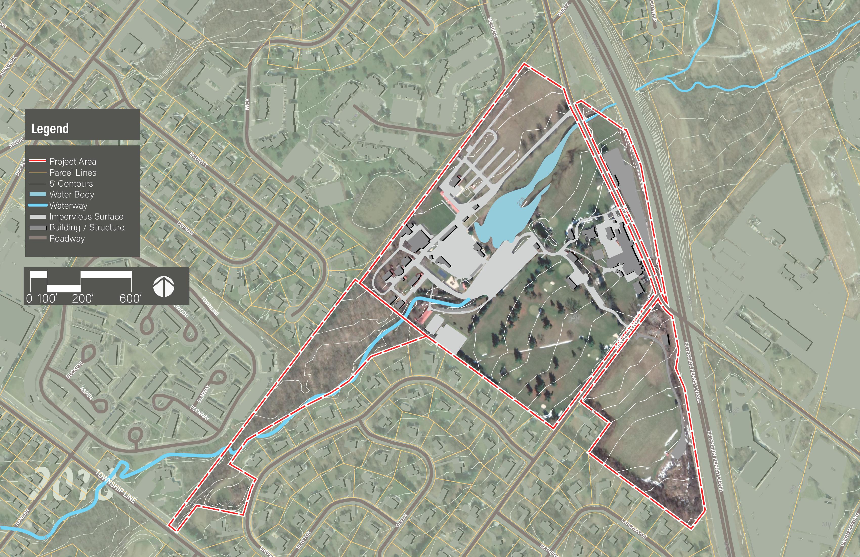
Dekalb Park
Blue Bell Villas
The Mews at Blue Bell
Henkels & McCoy
Townline Townhomes
Blue Bell Crossing
BrightView Landscapes
Mermaid Estates

Slide 39
Next Steps
6:00pm-8:00pm
Notes:
Pete

Slide 40
Contact Information
Simone Collins Landscape Architecture
610.239.7601
Peter Simone: psimone@simonecollins.com
Sarah Leeper: sleeper@simonecollins.com
Joe Wallace: jwallace@simonecollins.com
Notes:
Pete

