Slide 1

Whitpain Township
Mission Moment

Slide 2

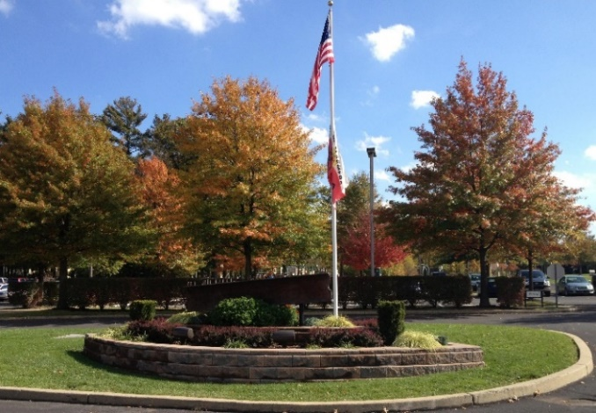
Mission
The mission of Whitpain Township Government is to efficiently, responsibly, and creatively provide the essential services that build value, enhance quality of life, and protect the health, safety, and rights for all who
live in, work in, and enjoy Whitpain.

Slide 3
Vision
Whitpain Township is a community that embraces the future while cherishing our heritage. We will continue to be recognized for our diversity, fiscal responsibility, and leadership in resource conservation. We shall never waver in our commitment to ensuring public safety and enhancing the quality of life of all of our fellow citizens.
Values
Integrity - We follow moral and ethical principles as we conduct our work. We are consistent in our deeds, methods, and expectations.
Stewardship - We value our natural, financial, and human resources and are diligent in protecting, preserving, and enhancing Whitpain Township.
Responsiveness - We respond quickly but thoughtfully to individuals, situations, and events.
Respect - We treat everyone with respect. Our actions and words will demonstrate consideration and appreciation of others.
Partnership - We establish transparent, long-term relationships that are based on clarity, trust, shared goals, and open communication with organizations that are committed to improving Whitpain Township.

Slide 4
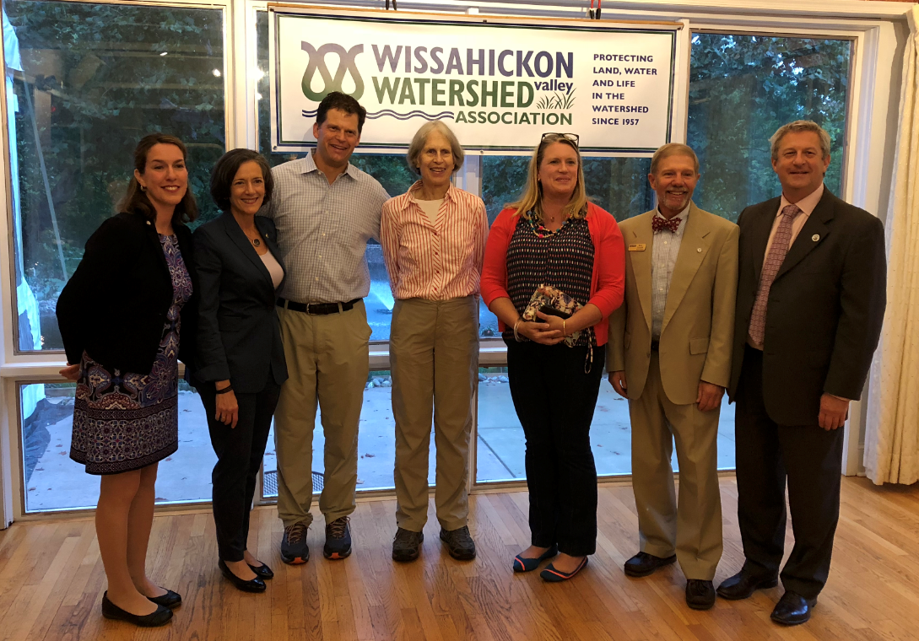
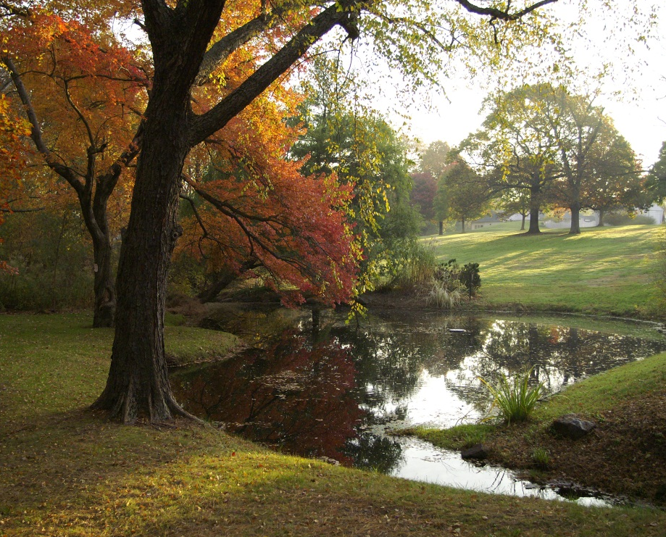
Stewardship & Sustainability
The Township has been on the cutting edge of regional stewardship efforts ever since acquiring the 62-acre Cook Farm Tract back in 1966
Since 1966, hundreds of acres have been permanently preserved in Whitpain – the most recent was last fall when we partnered with Montgomery County and Wissahickon Valley Watershed Association (WVWA) to purchase the 8-acre Cheston property on Lewis Lane
The Township and WVWA have combined to permanently protect 696 acres of open space in Whitpain
Mission Moment

Slide 5
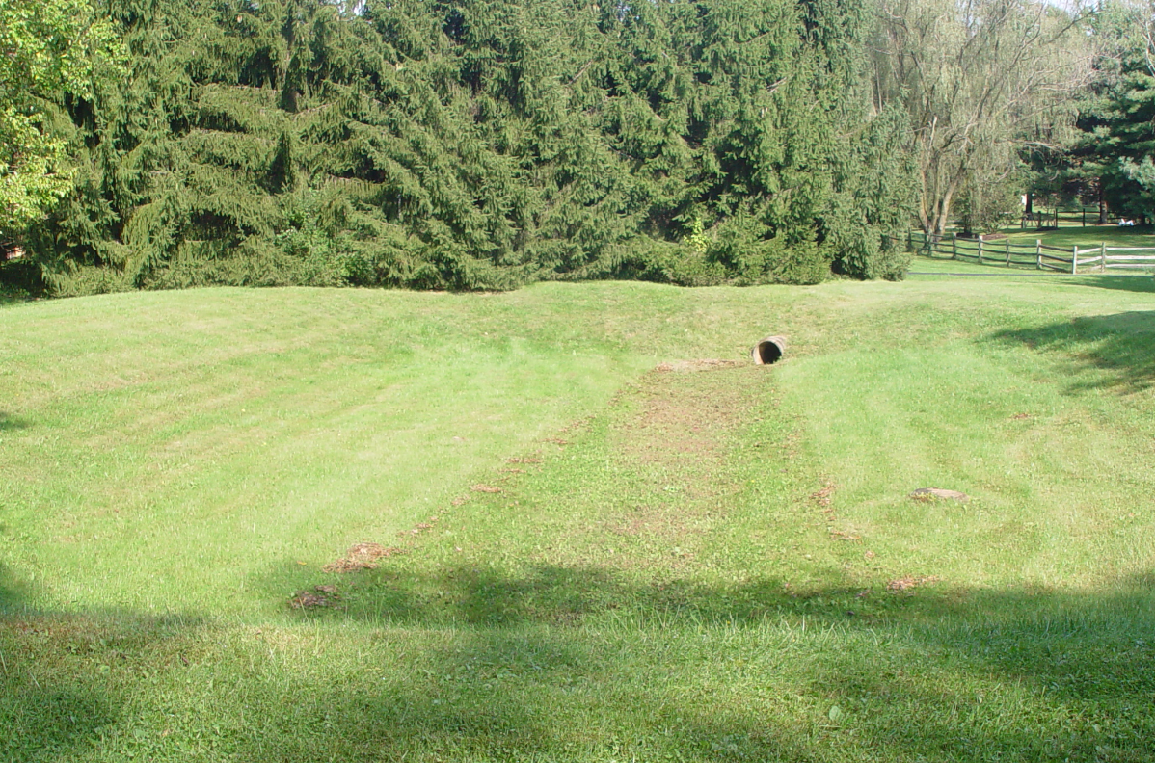
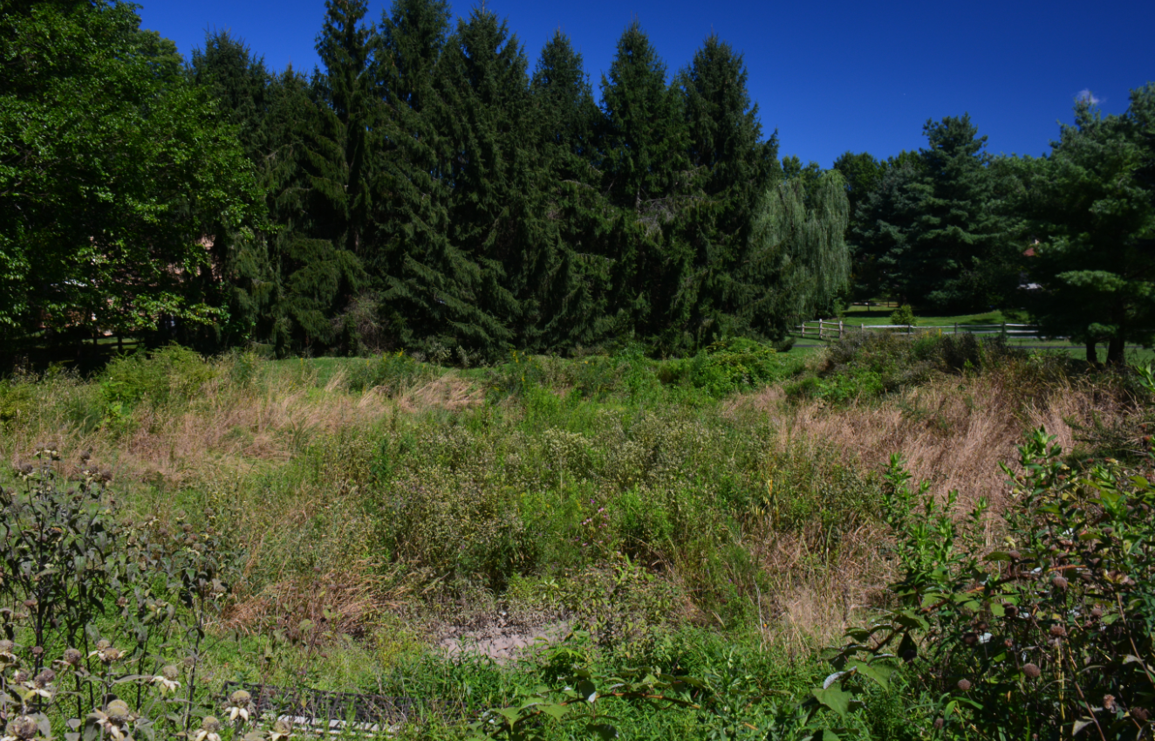
Enhancing Air & Water Quality
Whitpain’s conservation efforts extend well beyond property preservation and include air and water quality improvements
Air quality improvements consist of mitigating traffic congestion, increasing bikeability and walkability, and planting trees
On this evening’s agenda, we have a motion to award a $306,000 contract to install stormwater BMP’s at Wentz Run Park to improve water quality in the Stony Creek
The Township has also completed a number of basin retrofits in the Wissahickon Creek watershed to improve water quality to this impaired waterway
Before
After
Mission Moment
Valentine Basin

Slide 6
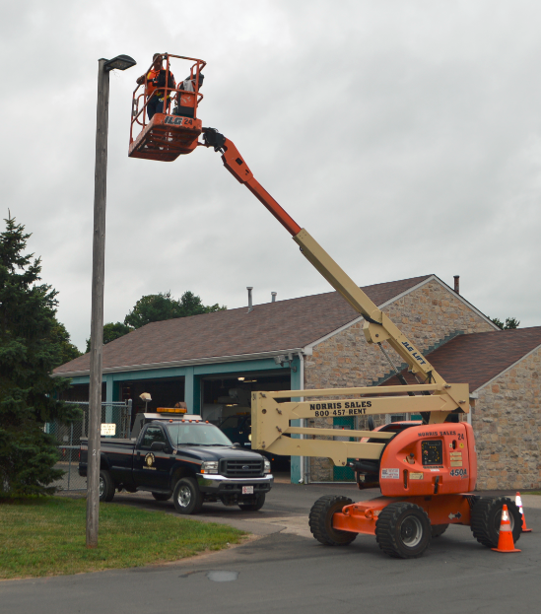
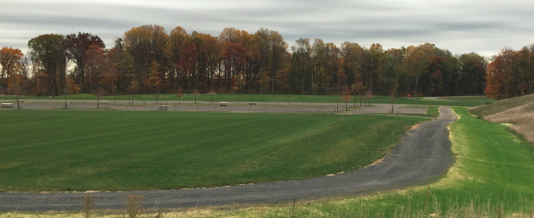
Other Sustainability Efforts
Assistant Engineer Greg Klucharich, named Whitpain’s Sustainability Coordinator in 2014
Township awarded the Gold Level Traffic Demand Management Recognition by the Greater Valley Forge Transportation Management Association as well as the Gold Level Sustainability Award
Centre Square Park constructed with a state-of-the-art stormwater management system that captures rain that is used to irrigate playing fields
Energy efficiency can be seen throughout Township-owned properties, including LED lighting, motion sensors, LED traffic signals, improved insulation, and many other measures
Worked w/ SEPTA to extend bus service to Whitpain to provide commuting alternatives
Centre Square Park
Mission Moment
LED Lighting Upgrades at Wentz Run Park

Slide 7
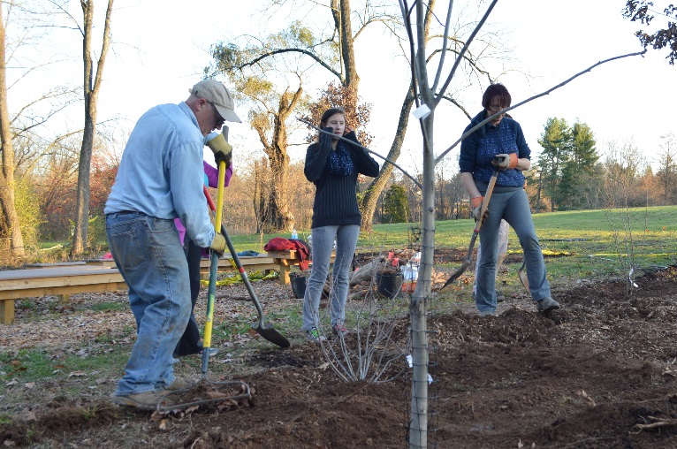
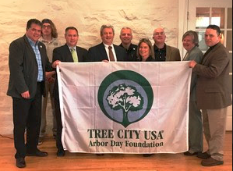
Tree City USA
Tree City USA Community Designation for 24th consecutive year (since 1994)
The Township consistently receives a Tree City USA Growth Award for demonstrating environmental improvement and a higher level of tree care.
Benefits of Trees
Reduce temperatures
Block & absorb noise
Absorb carbon dioxide and carbon monoxide
Release oxygen
Reduce runoff and decrease soil erosion
Mission Moment

Slide 8
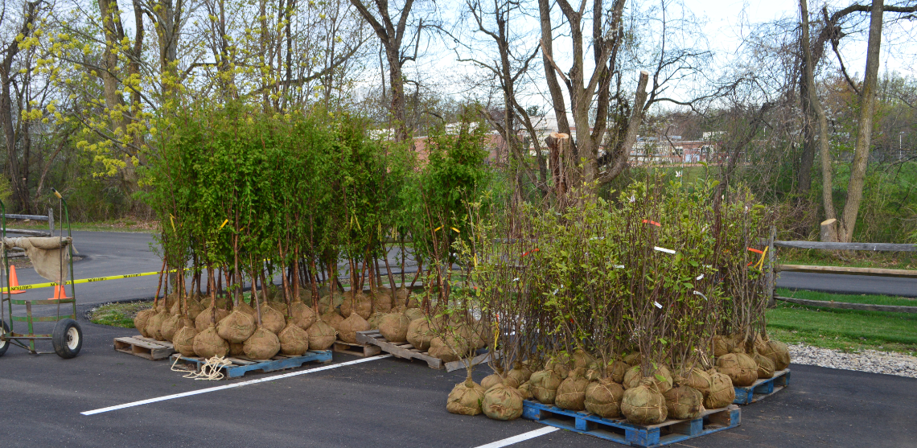
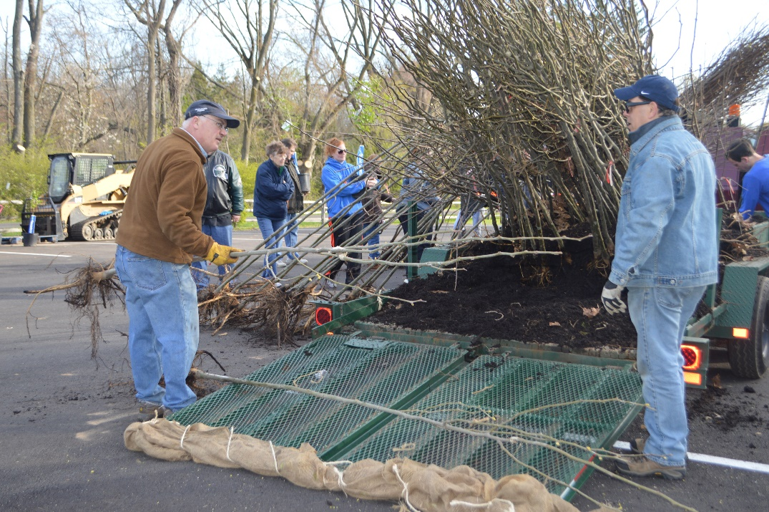
Shade Tree Giveaway
The annual Shade Tree Giveaway is Sunday, April 28th at 8 am at Prophecy Creek Park – Free trees and mulch will be distributed on a first-come, first-served basis. Deer protective wrap is also available free of charge while supplies last.
Free Shade Tree program is available to a limited number of property owners. A Free Shade Tree, 2-2.5 inches in caliper is available for qualifying residents
Mission Moment

Slide 9
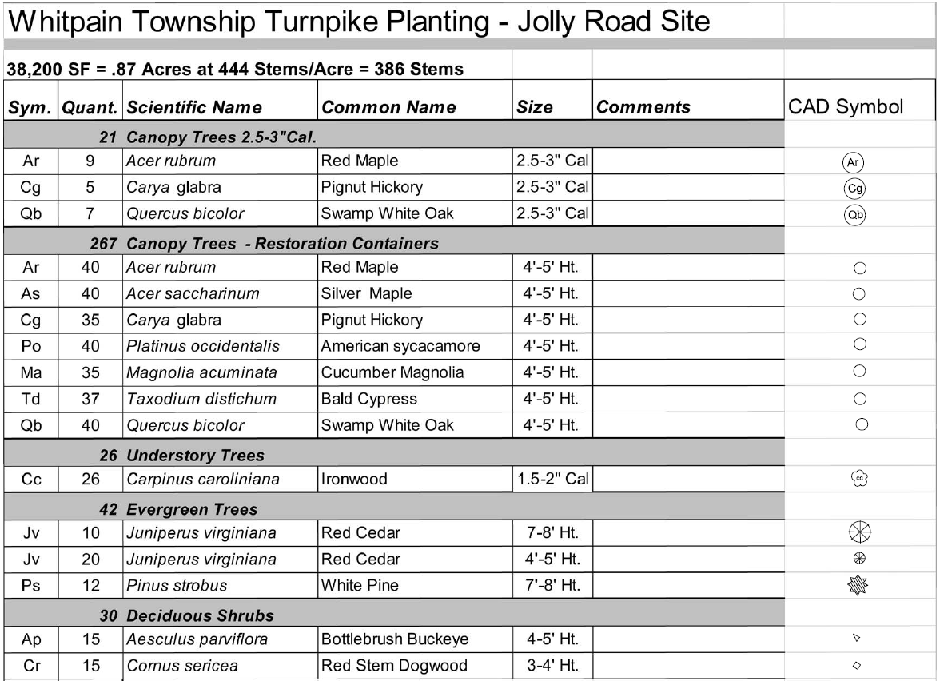
Turnpike Planting Plan at Jolly & Wentz Roads
Whitpain Township was awarded a $50,000 Keystone Communities Program Grant to replant a section of the Pennsylvania Turnpike Corridor along Wentz and Jolly Roads
The grant was sponsored by State Senator Daylin Leach
Morris Arboretum Forestry Division has already prepared a planting plan for the project
386 total trees are to be planted at Wentz and Jolly Roads on .87 acres of land (38,200 square feet)
Mission Moment

Slide 10
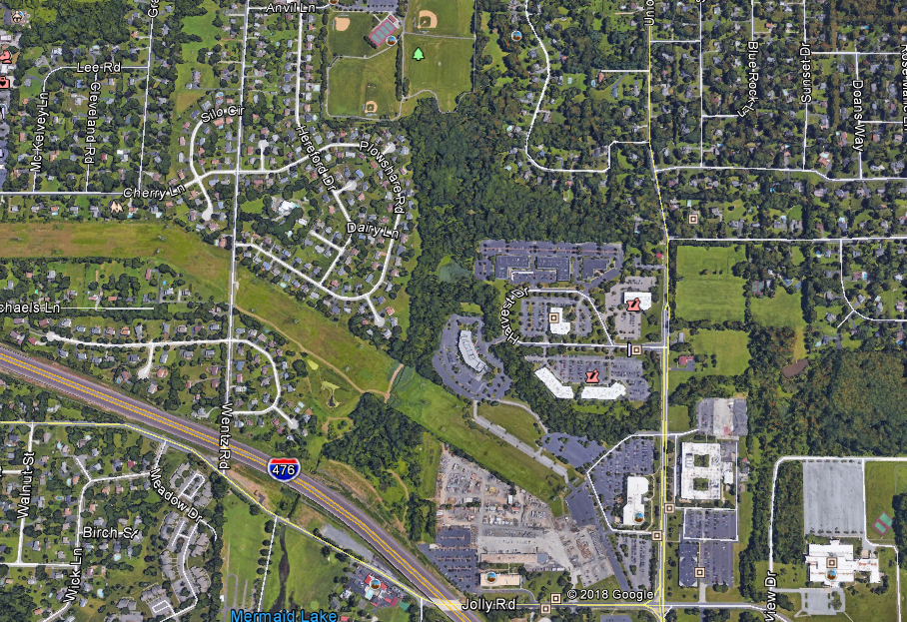
Turnpike Planting Plan at Jolly & Wentz Roads in Context
Whitpain Township Building
Planting Area
Wentz Road
PA Turnpike

Slide 11
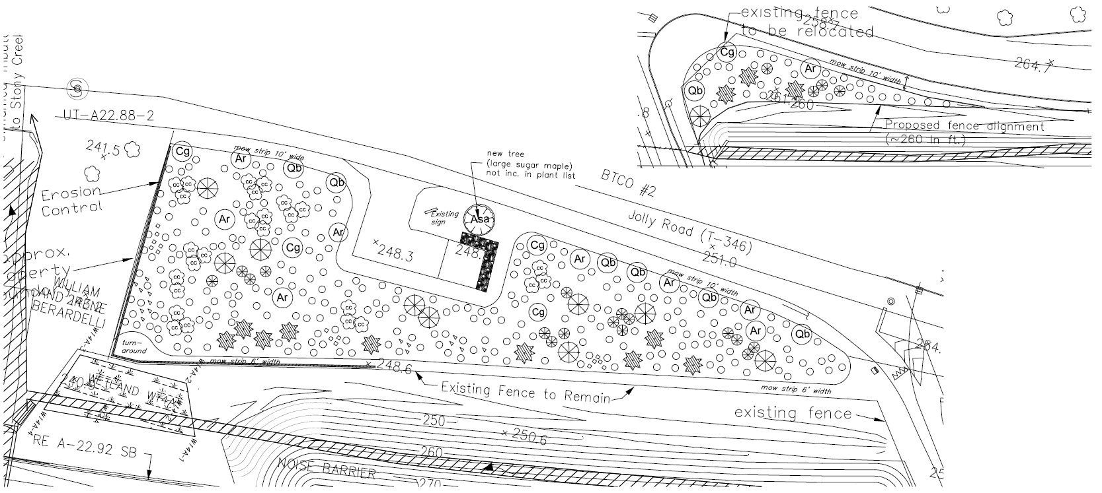
Turnpike Planting Plan at Jolly & Wentz Roads
Mission Moment

Slide 12
Please join Whitpain Township
in Celebrating
Earth Day on April 11th from 9:15 am – 11:15 am
at Prophecy Creek Park
&
The Shade Tree Giveaway on Sunday, April 28th at 8:00 am at Prophecy Creek Park
Mission Moment

