Slide 1
Sustainable Development Strategies
Whitpain Township
Jeffrey Featherstone, Ph.D.
Director, Temple University Center for Sustainable Communities
February 25, 2015

Slide 2
What is Sustainable Development?
Some Definitions:
“Sustainable development is development that meets the needs of the present without compromising the ability of future generations to meet their own needs.”
Brundtland Report (1987)
“Sustainability means making decisions, both as individuals and as a society, that seek to maintain economic opportunity and community well being while protecting and restoring the natural environment upon which people and economies depend.”
CSC (2005)

Slide 3
Sustainability Drivers:
Global Climate Change
Unmanaged Growth and Development
Urban Sprawl
Fragmentation/Inefficiencies/Inequities
Negative Externalities
Flood losses
Infrastructure decay
Traffic congestion
Environmental degradation

Slide 4


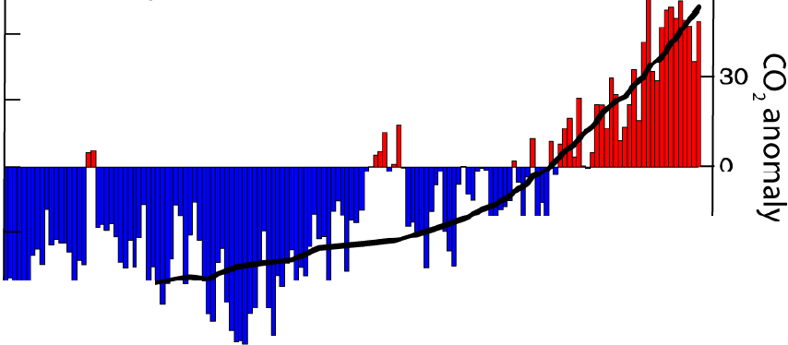
u
Global temperature and carbon dioxide 1860-2009
60
0
0.4
ro
E 0.2
0
c
ro
<lJ
i....
::l
+-'
0
-0.2
QJ
E-o.4 llL . .. .
-30
"'O
lJ
3
-so <
Q.
& Temperature
-0.6.. --
1860 1880
--- ---
1900
--
--
- C02
--
1980
-------'
2000
1920
Year
1940
1960

Slide 5
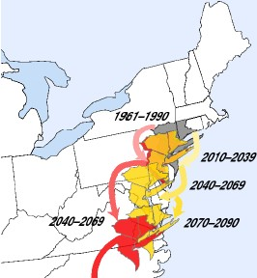
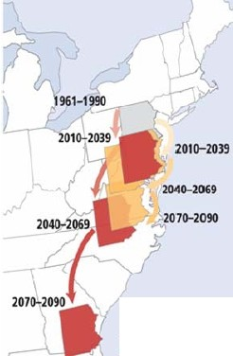

Summer Heat Index
Eastern Pennsylvania
Tri-State Region
Low Emission Scenario - heat index similar to Washington D.C. by mid­ century,like Virginia by
later part of century.
High Emission Scen;.:i rio ­ heat index similar to
sout hern VA by mid­ century,like Sourth
Carolina or Georgia by later part of century.
l?JI
IHgher·Emissions Scenario
lower-Emis9onsScenario
Hl lter EmisshnsS:eno/'/o LowerEmissions&enaJfo

Slide 6
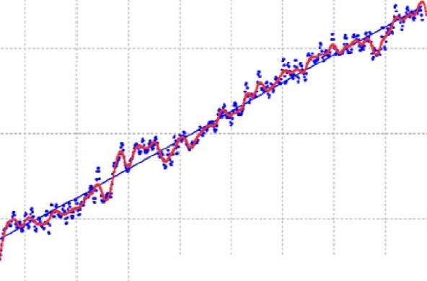
Global average sea level is rising from expansion of water due to warming and melting glaciers
40
Slope ..3.32 mmtyr
- Trend li ne
30
Since 1992 sea
level has risen SSmm
( 2.2 inches)
20
10
mm
0
-10
-20
-30
0 CLS,LEGOS,CNES
1994 1996 19!>8 2000 2002 2004 2006 2008 2010
Source: www.aviso .oceanobs .com/en/news/ocea n-indicators/ mean-sea-level/
-40 >92

Slide 7
Future Consequences
More frequent and intense storms
More floods and droughts
Oppressive hot summer days
Heat stress
More infectious diseases
More invasive species
Loss of biodiversity
Ecosystem destruction

Slide 8
Mitigation Strategies
Improve Knowledge Base
Adapt to Climate Change
Promote Smart Growth
Implement Community Strategies

Slide 9



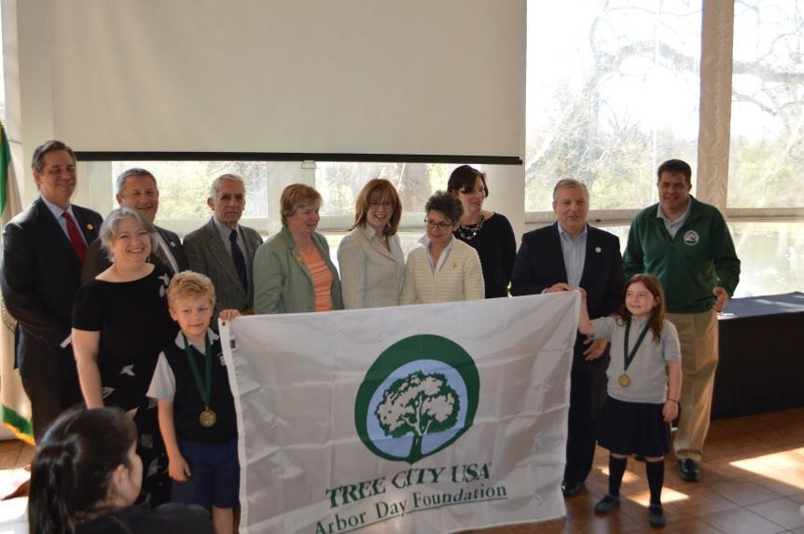
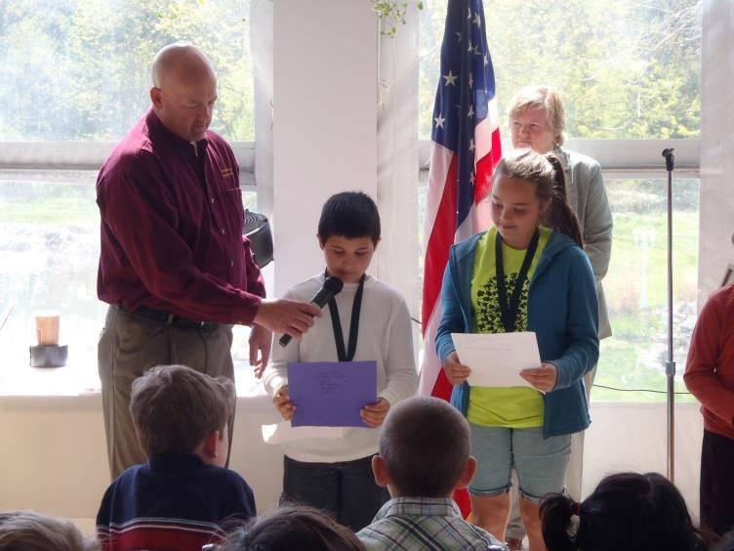
Existing Sustainable Practices in
Whitpain Township
 Over 425 acres of protected, active, passive, and
conservation of open space
 Tree City USA Community since 1994
 Received Prestigious Growth Award by National
Arbor Day Foundation since 1999
 Annual Earth Day Celebration for 19 years

Slide 10



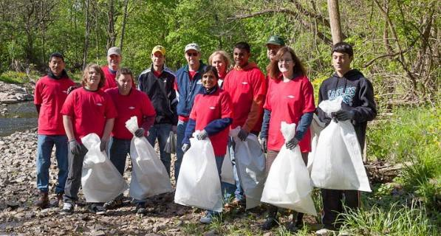
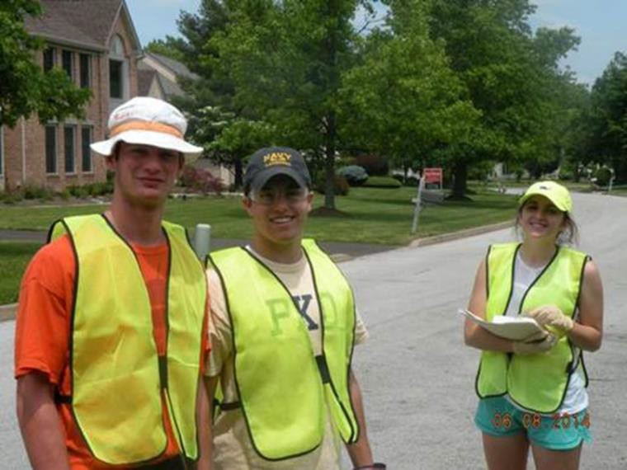
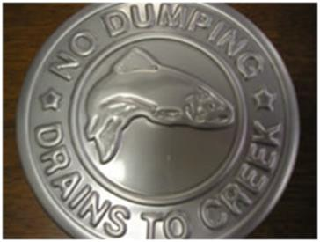
Existing Sustainable Practices in
Whitpain Township
 Shade Tree Commission’s Annual Tree Giveaway
300 trees distributed in 2014
 Wissahickon Creek clean- up in partnership with WVWA
 Conservation Practices - converting mowed parkland to meadows
 Public Outreach - Boy Scout Stenciling project and Rain Barrel Workshops

Slide 11



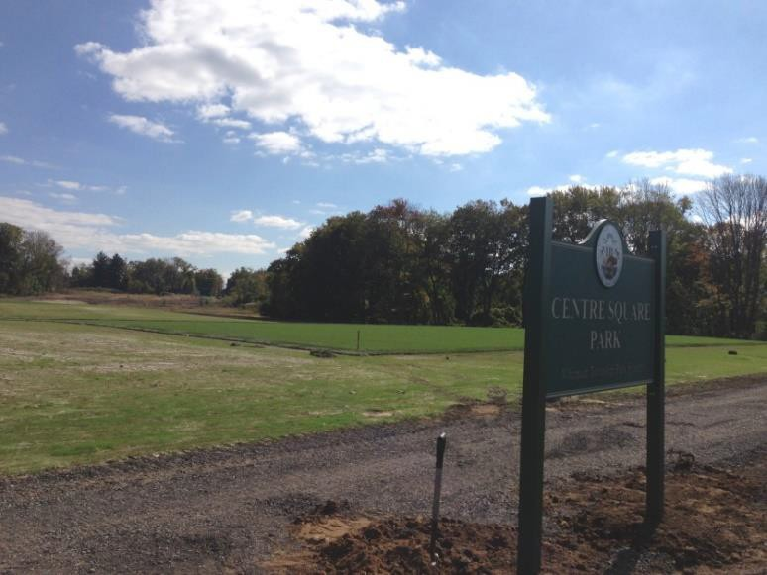
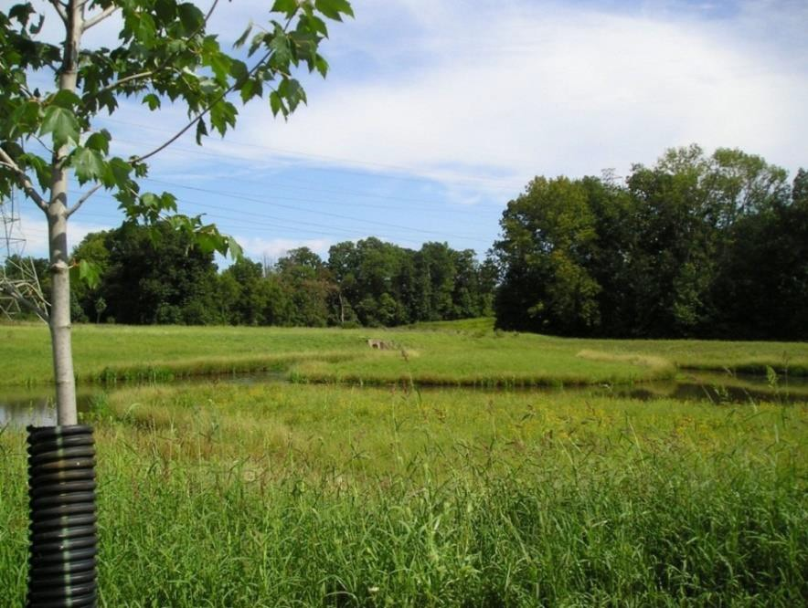
Existing Sustainable Practices in
Whitpain Township
 Community Improvements
Centre Square Park
Development and Management of SWM Program to Promote Residential Stormwater BMP’s
& Minimize Impervious Surfaces
 Infrastructure Improvements
Stormwater Basin Retrofits
LED Traffic Signal Upgrades
Coordination with SEPTA regarding mass transit opportunities

Slide 12
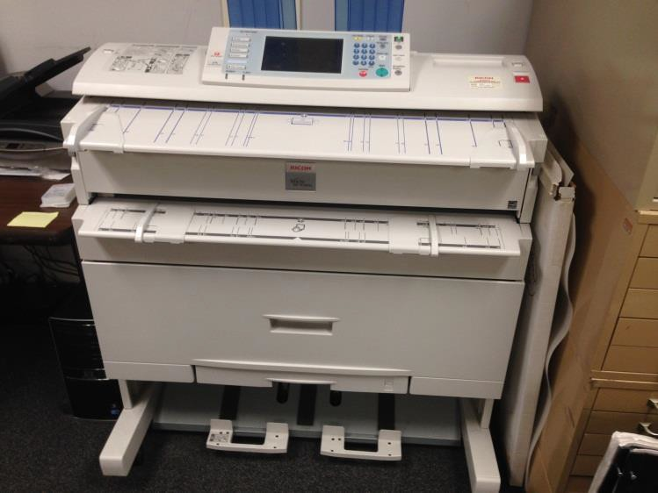
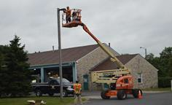
Existing Sustainable Practices in
Whitpain Township
 Workplace Improvements
Digital Scanning Project
LED outdoor lighting
High efficiency HVAC system
Motion sensor indoor lighting
New energy efficient windows

Slide 13
Strategy #1
Conduct a Sustainability Audit to determine baseline conditions for community and municipal government
GHG Emissions
Water and Wastewater Usage
Solid Waste Recycling and Reuse

Slide 14
CO₂ Equivalent Emissions
for Montgomery Township in 2005
Transport
40.4%
Waste, 1.1%
Industrial, 11.7%
Other, 2.8%
Residential, 23.4%
Commercial, 20.6%

Slide 15
Comparing Per Capita Emissions by
Source (metric tons of CO₂ equivalent)
18
16
14
12
10
8
6
4
2
0
Montgomery Township
Haverford Township
Upper Dublin Township
Lower Makefield Township
Entire DVRPC Region
Total
Residential
Transportation
Commercial & Industrial

Slide 16








Average Per Capita Water Use
120
100
80
60
40
20
0
Gallons per day
Montgomery
Township
NWWA
service area
Pennsylvania
U.S.

Slide 17
Strategy #2
Improve baseline data for streams
and watershed conditions
Hydrologic and hydraulic
modeling of watersheds
Field surveys
Better mapping

Slide 18
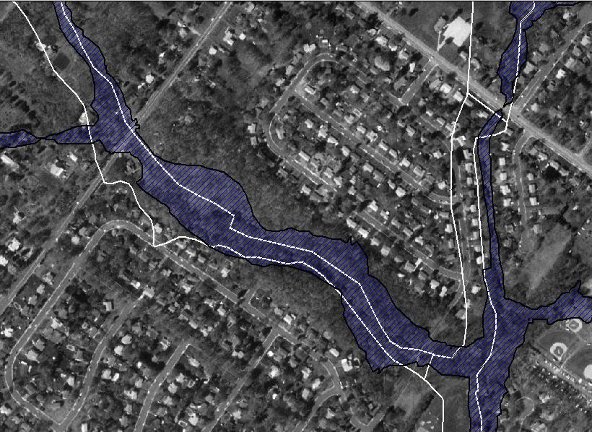
Pennypack Creek
18
White Lines= FEMA Floodplains
Blue= Revised Floodplains

Slide 19
Strategy #3
Increase floodplain delineations to account for future development and climate change
Redefine flood hazard areas by using the 500-year floodplain for regulation purposes
Seek buyouts for flood-prone properties

Slide 20
Strategy #4
Participate in FEMA’s Community Rating
System Program
Goals: reduce flood damages, strengthen flood insurance though a more comprehensive program
Activities: public information, mapping and regulation, flood damage reduction, and flood preparedness
Benefits: Reduced flood insurance premiums and greater resilience to flooding

Slide 21
Credit Points | Class | Premium Reduction SFHA | Premium Reduction Non-SFHA
4,500+ | 1 | 45% | 10%
4,000 – 4,499 | 2 | 40% | 10%
3,500 – 3,999 | 3 | 35% | 10%
3,000 – 3,499 | 4 | 30% | 10%
2,500 – 2,999 | 5 | 25% | 10%
2,000 – 2,499 | 6 | 20% | 10%
1,500 – 1,999 | 7 | 15% | 5%
1,000 – 1,499 | 8 | 10% | 5%
500 – 999 | 9 | 5% | 5%
0 – 499 | 10 | 0 | 0

Slide 22
Strategy #5
Improve stormwater management
Update stormwater requirements
Adopt new control measures
Require bigger facilities in new construction
Retrofit existing sites
Retrofit detention basins
Construct new BMPs

Slide 23
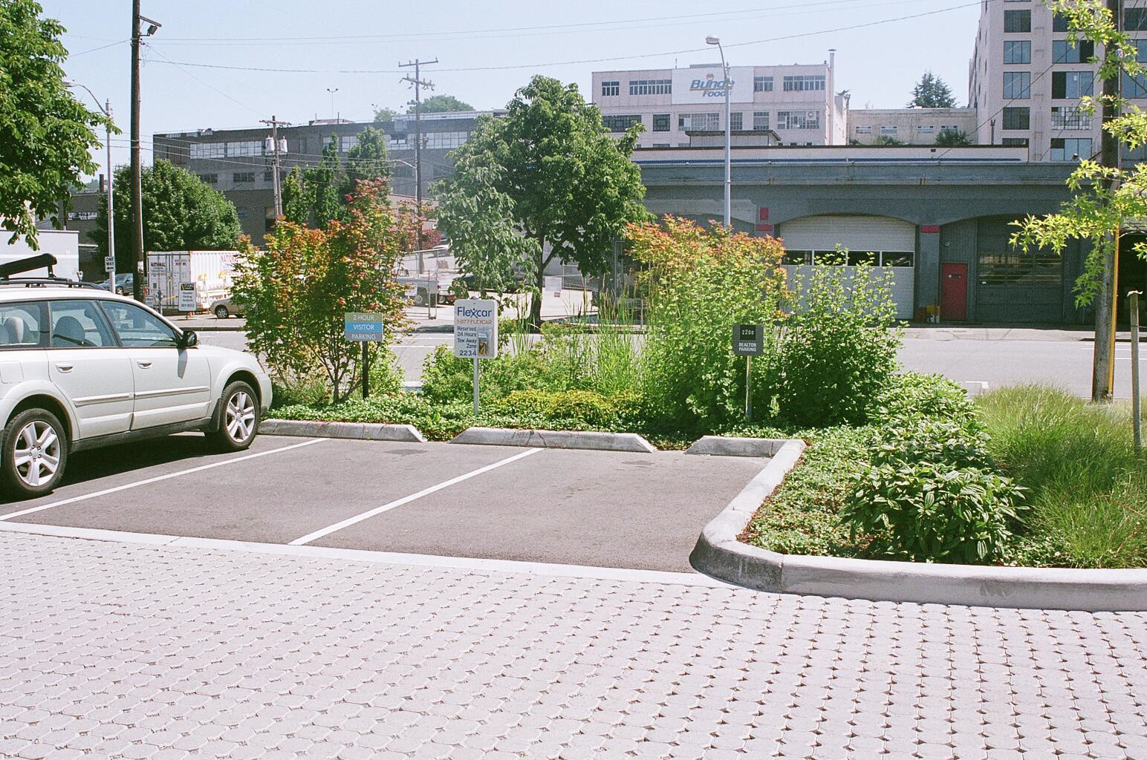
Pervious Driveway and Impervious Parking
Bays with Bio-Infiltration

Slide 24
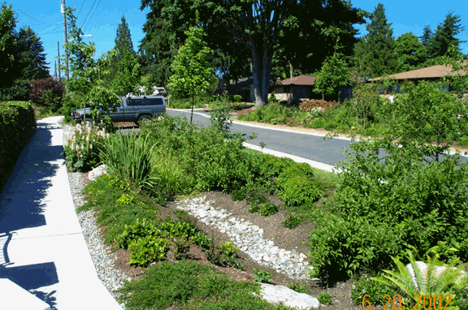
Vegetated Swale
Green Streets Program Portland Oregon

Slide 25
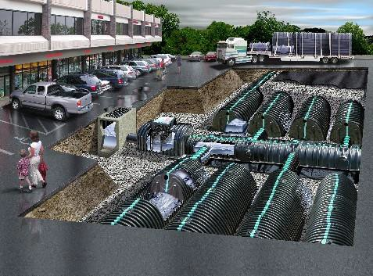
Underground Infiltration and Retention
Cultec, Inc.

Slide 26
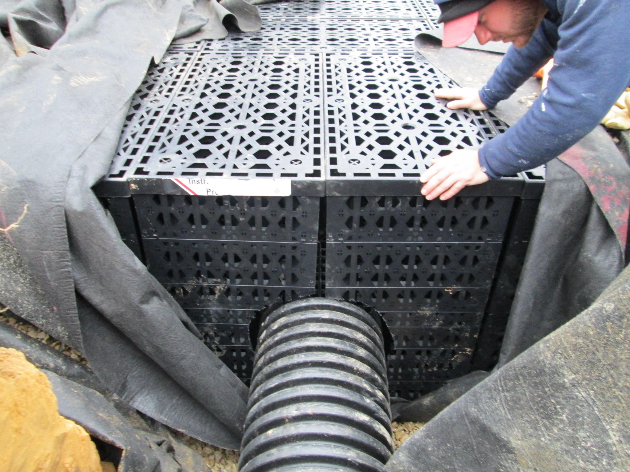
Infiltration Galleries

Slide 27
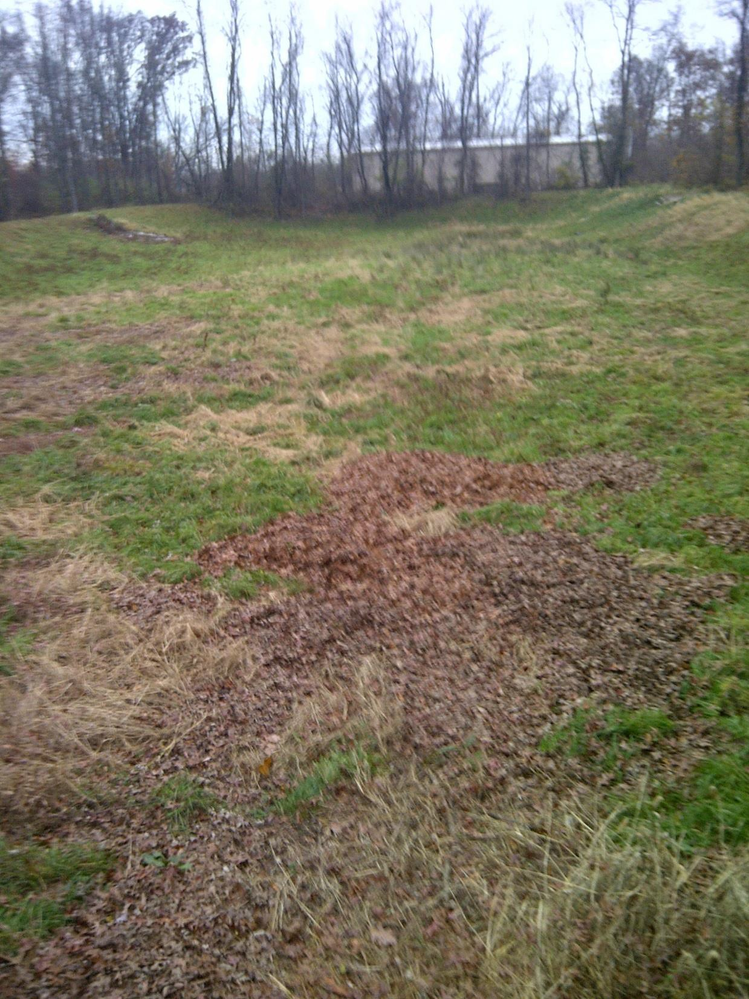
Village Circle Basin

Slide 28
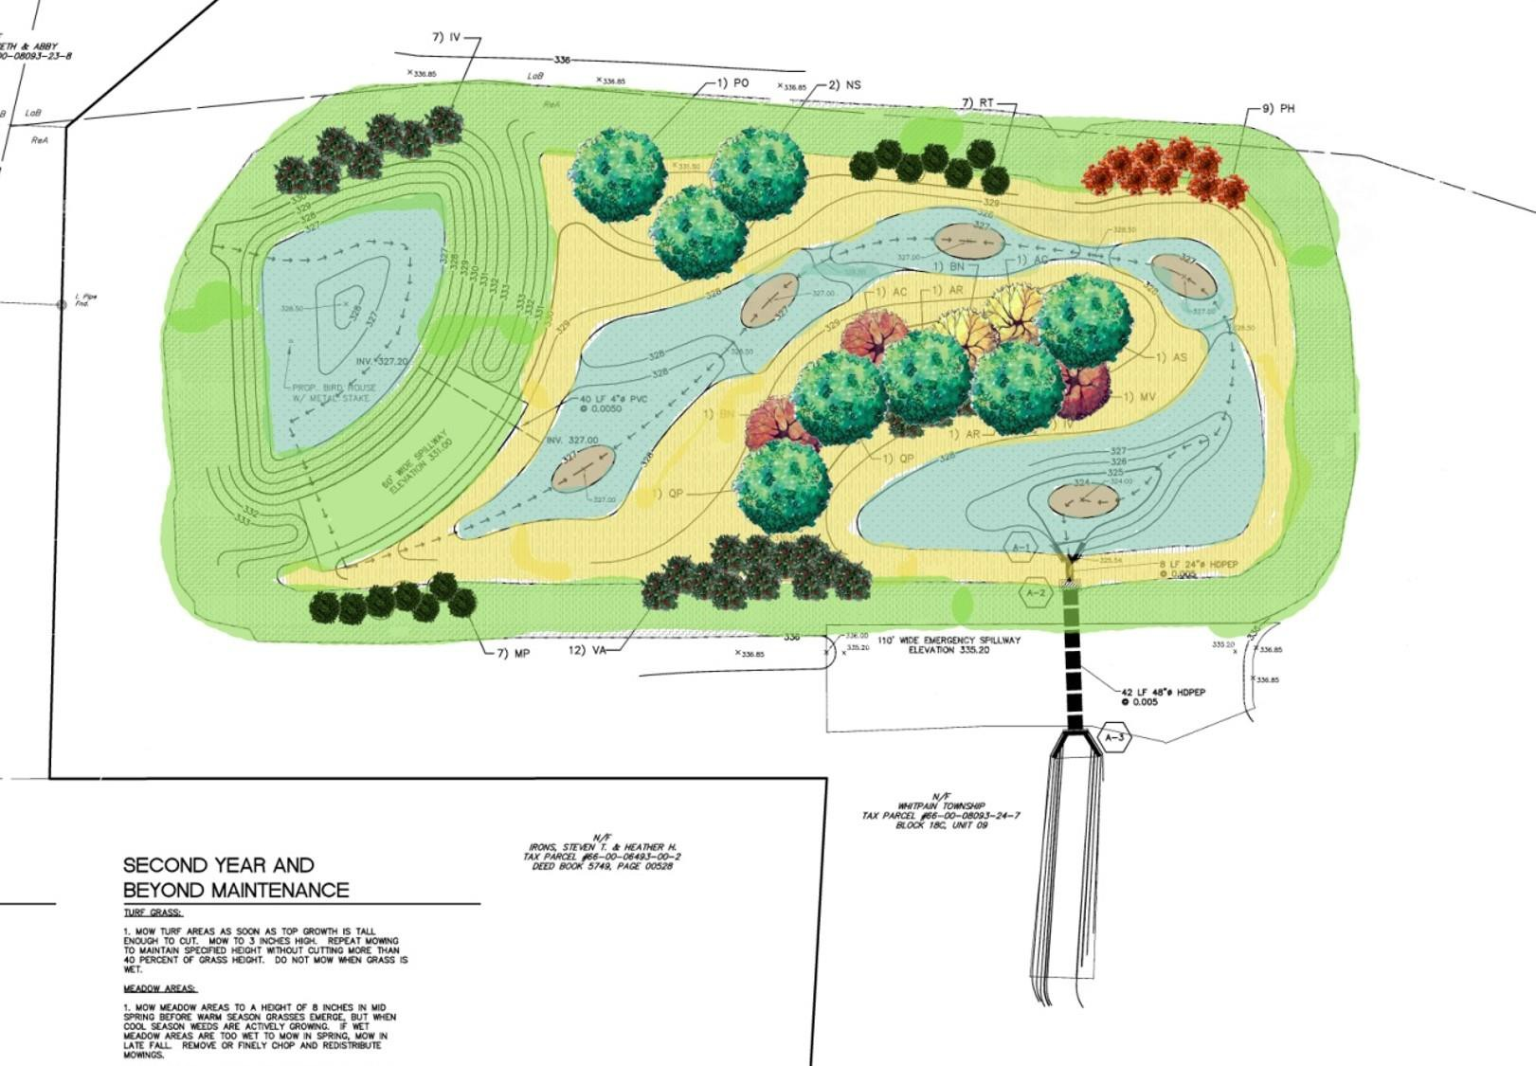
Village Circle Basin Plan

Slide 29
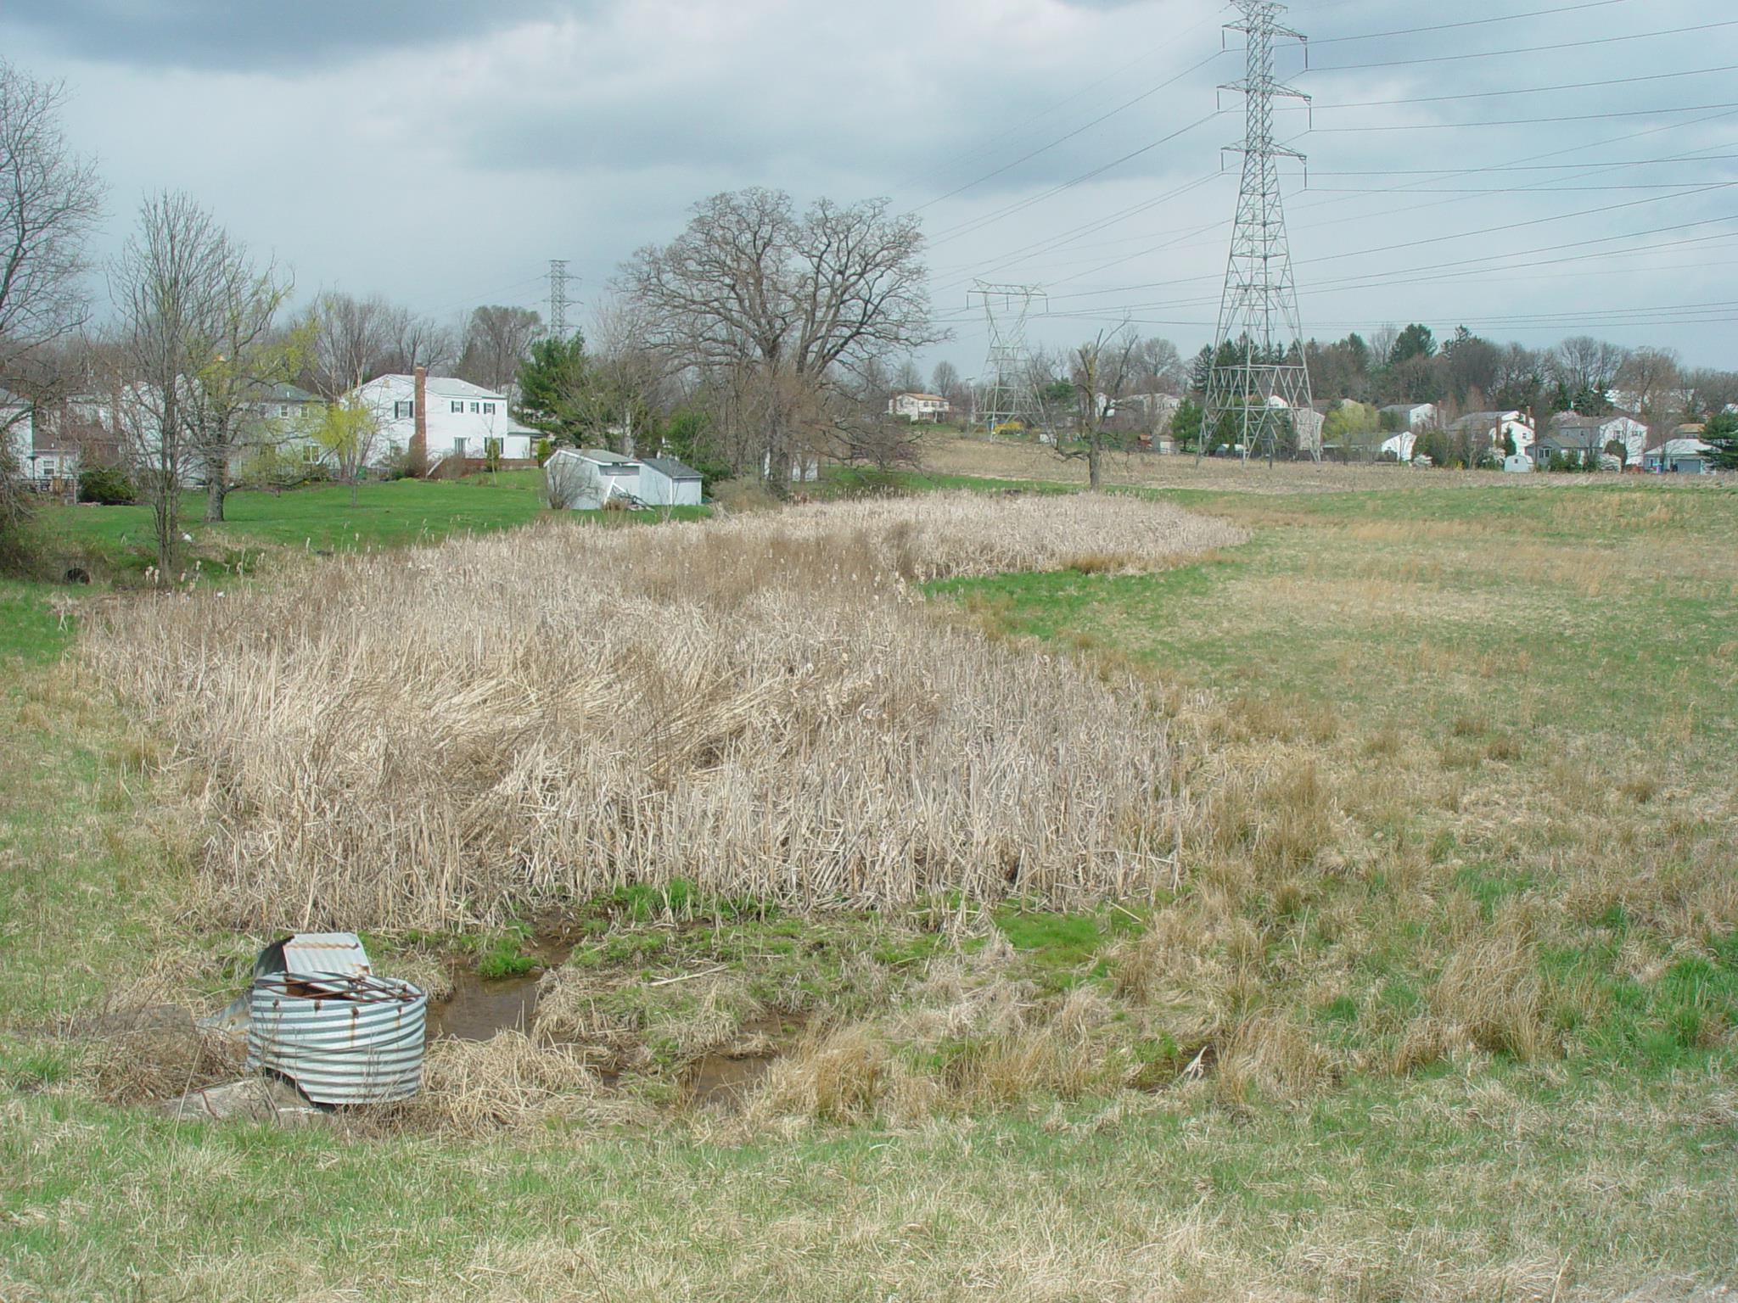
Blue Bell Run Basin

Slide 30
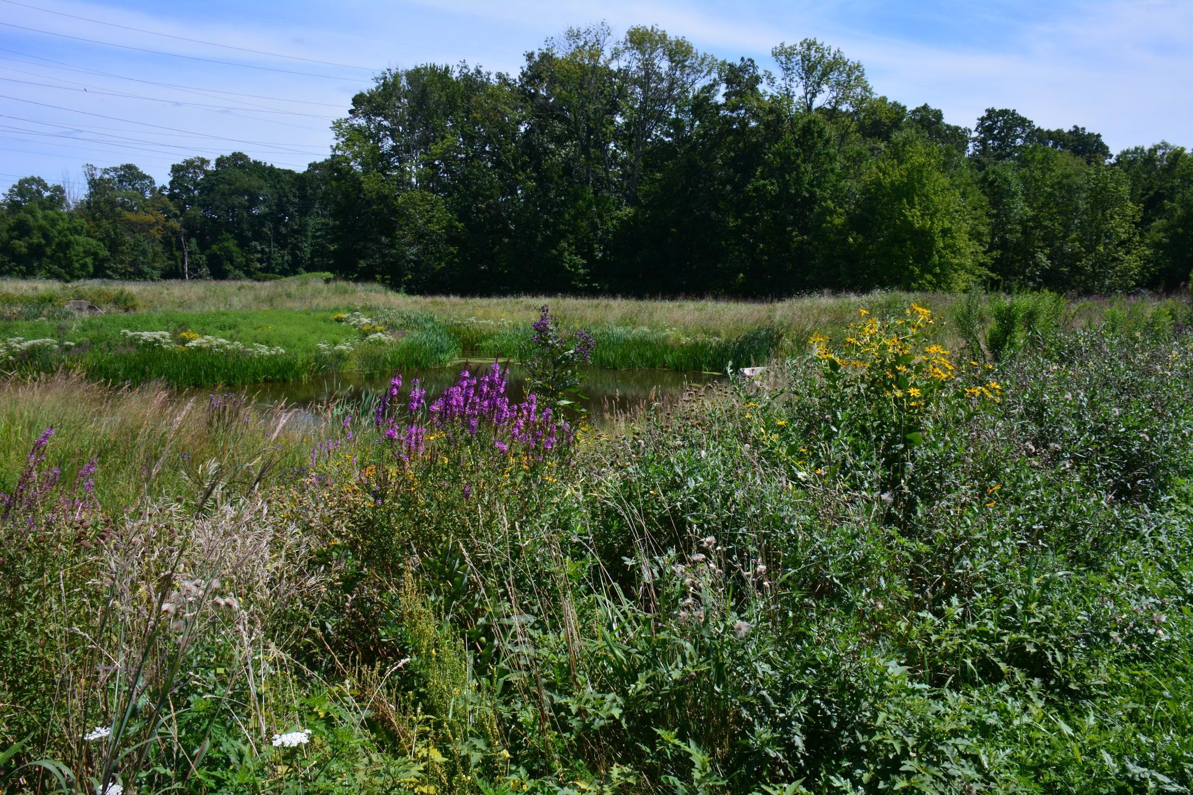
Blue Bell Basin Retrofit
Underground Infiltration and Retention
Cultec, Inc.

Slide 31
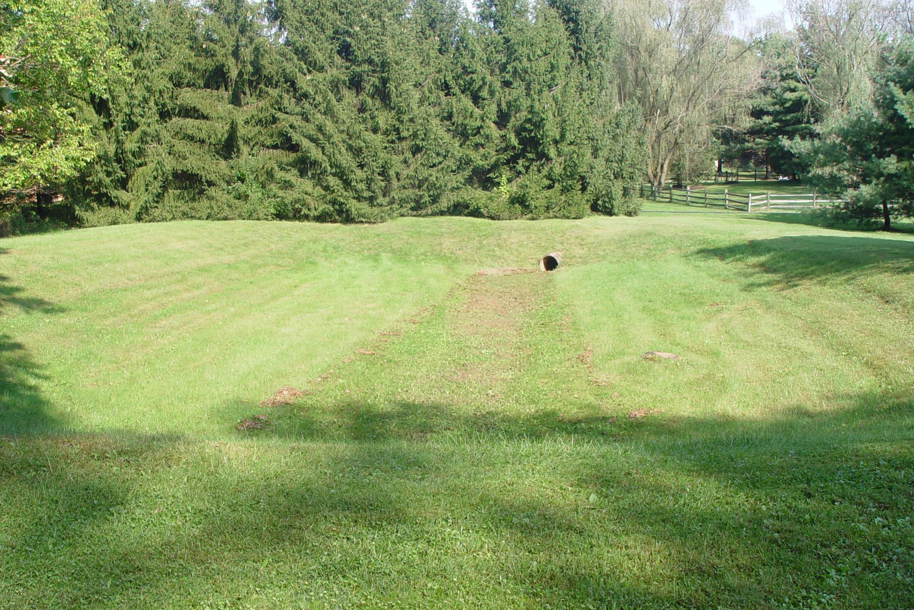
Valentine Basin

Slide 32
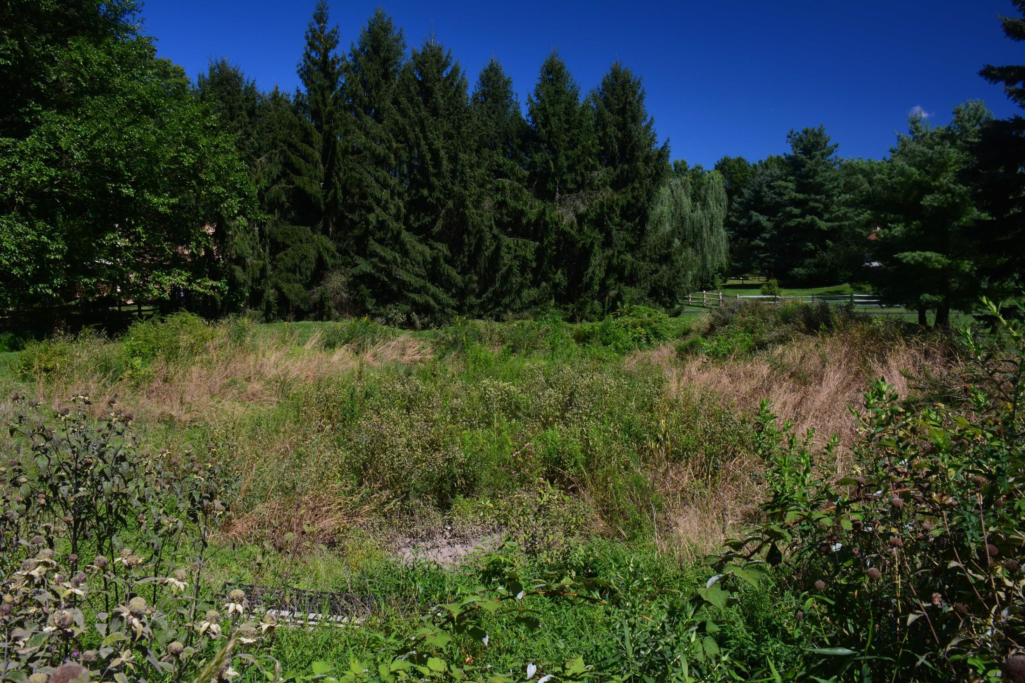
Valentine Basin Retrofit

Slide 33
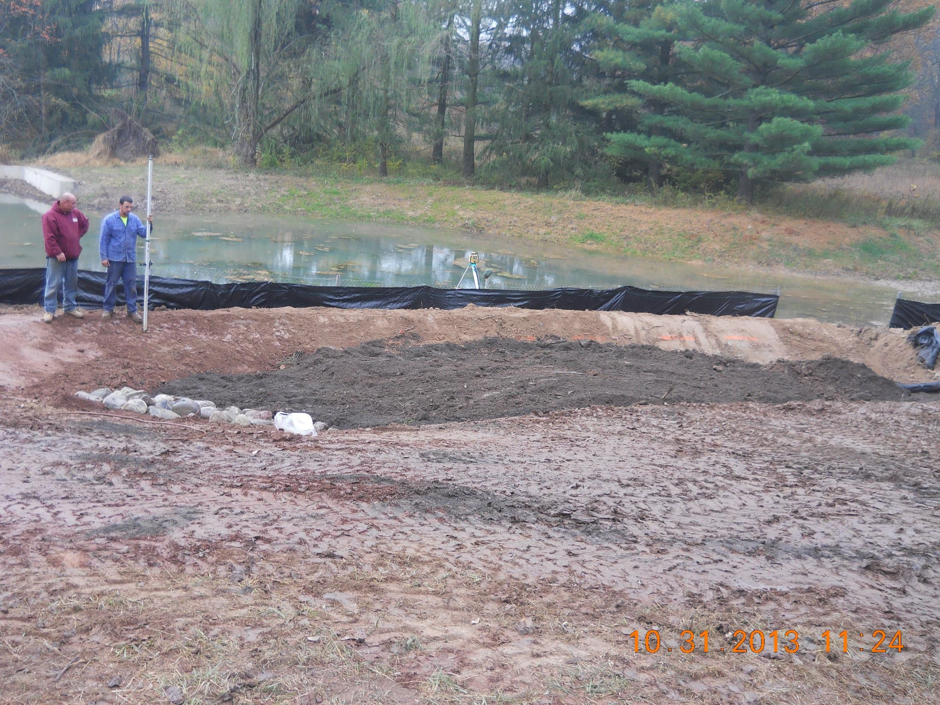
Rain Garden Installation

Slide 34
Strategy #6
Improve Water and Energy Conservation
Adopt water conservation rates (Ambler Water)
Inclining block rates
Excess use surcharges
Seasonal rates
Require energy conservation
Update building codes
Require LEED design
Retrofit municipal buildings
Energy efficient lighting
Water conservation fixtures and fittings
Stormwater management

Slide 35
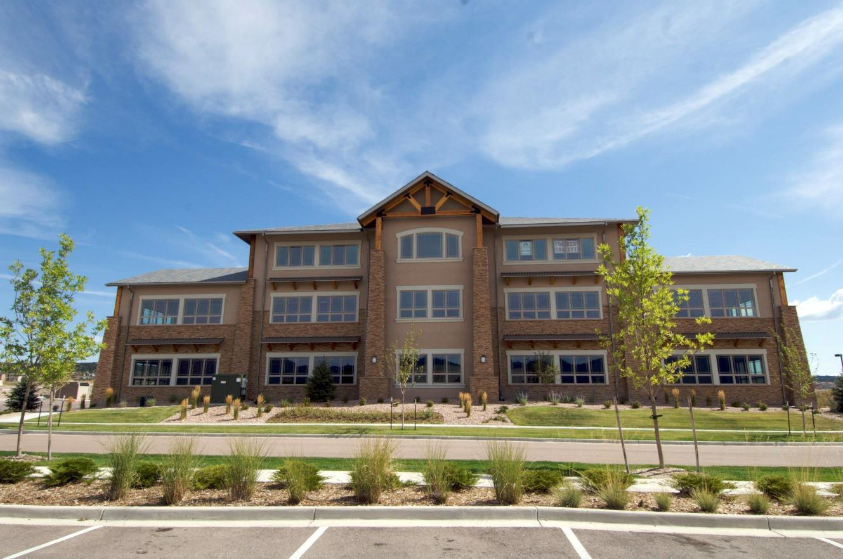

Sustainable Building Design
Image Sources- http://creadvice.files.wordpress.com/2011/08/leed.jpg http://www.csigc.com/images/LEED%20Projects/DSC_0056.jpg

Slide 36
Strategy #7
Encourage more mixed-use
development through village centers
West Ambler
Broad Axe
Blue Bell
Centre Square
Encourage pedestrian friendly environments

Slide 37
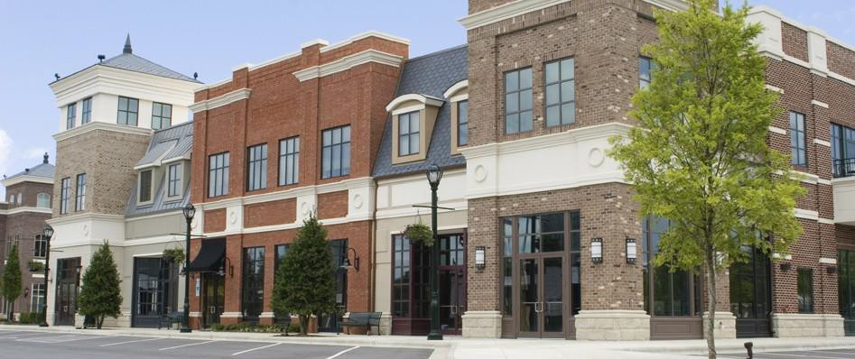
Example of Mixed-Use Development
Image Source- http://omni-construction.com/data1/images/mixedusebuilding.jpg

Slide 38
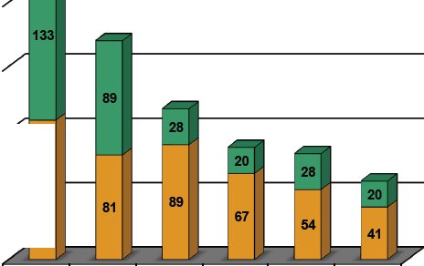
Jonathan Rose Companies LLC
Location: Urban Ys. Suburban Green
0
Suburban SF Detached (242 MBTU)
Green Suburban SF Detached (170 MBTU)
Urban SF Attached (117 MBTU)
Green Urban
SFAttached
(87 MBTU)
Urban Multifami y (82 MBTU)
Green Urban Multifamily (61MBTU)
Single Family Household Type
8Jonathon Rose companies,uc2009

Slide 39
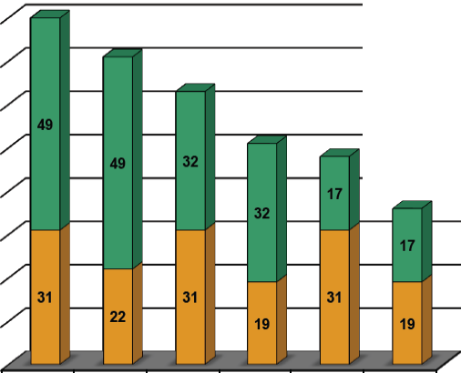
Jonathan Rose Co1npanies LLC
Location: Urban YS. Suburban Green
80
•Transportation Use COffice Building Use
...
m
70
>..-. ..II.:.
60
QJ 0
a. 3: 50
::::> G>
m :e 40
I- CJ
c o
.2 ...
::
::!:
30
20
10
0
Suburban Avg (80 MBTU)
Suburban Green (71 MBTU)
Seattle Avg (63 MBTU)
Seattle Green (51MBTU)
NYC Midtown Avg (48 MBTU)
NYC Midtown Green (36 MBTU)
Office Location and Type
Cl Jonatho't Rose Comportl•s, LLC 2009

Slide 40
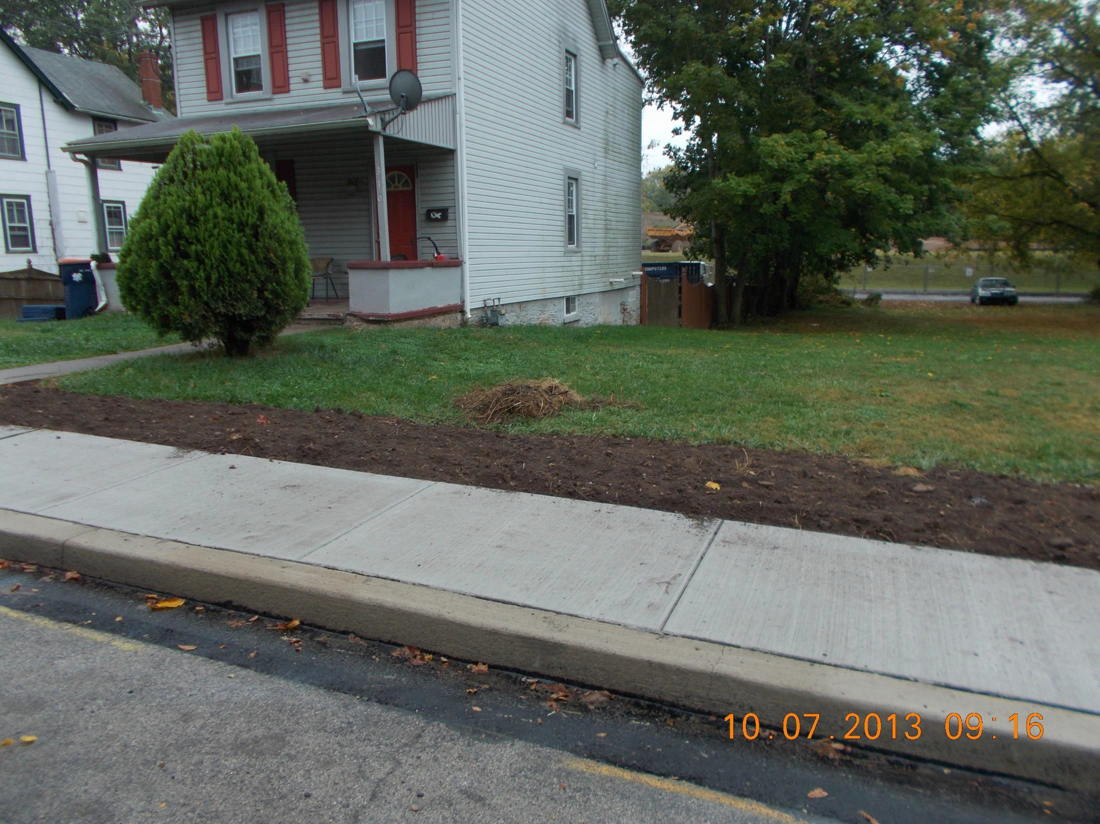

Slide 41
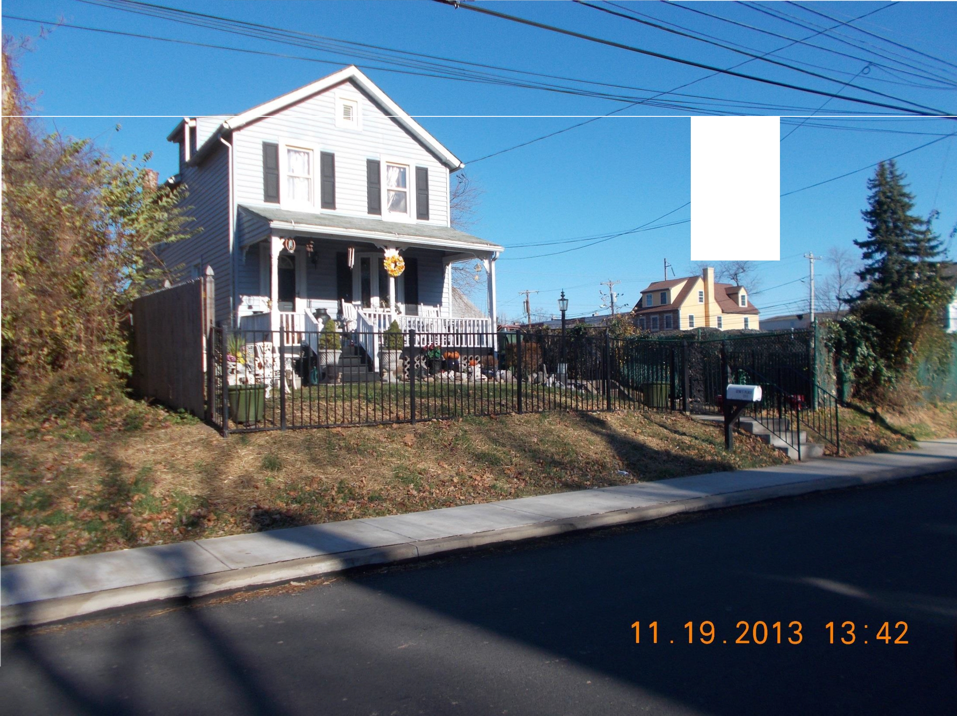
/
/
/
/ ---
/
/"

Slide 42
Strategy #8
Continue open space protection
Restore degraded landscapes
Integrate trail system

Slide 43
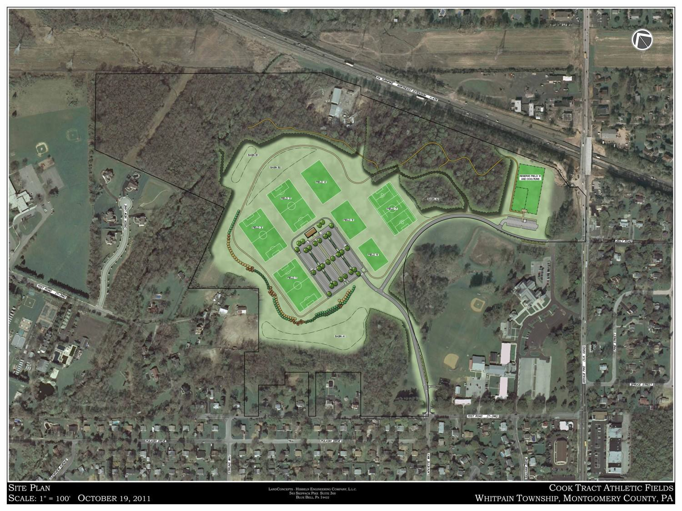

Slide 44
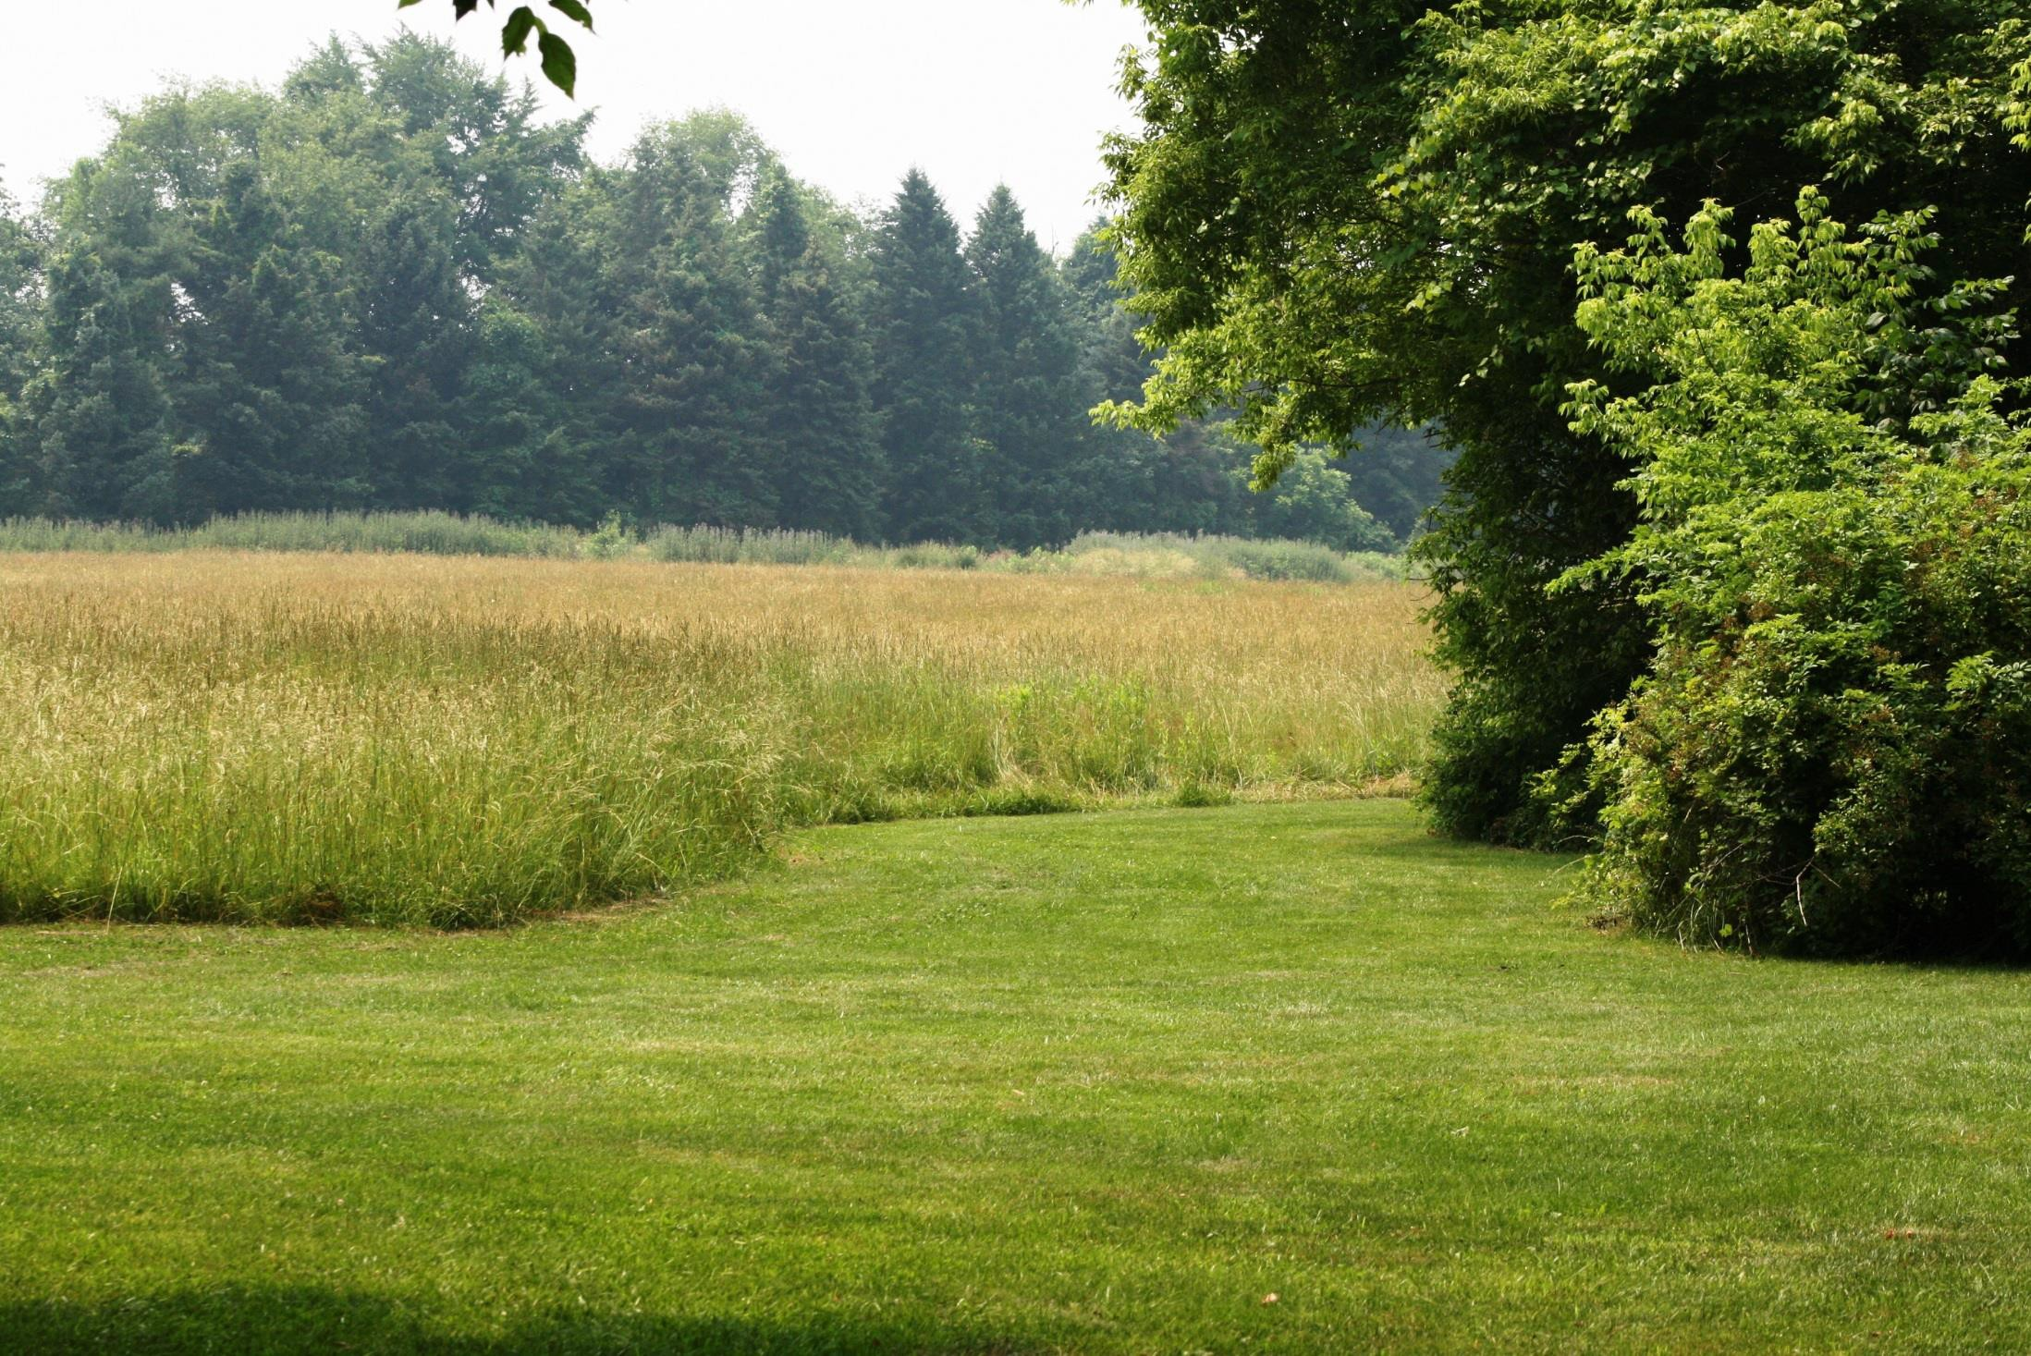
Prophecy Meadow

Slide 45
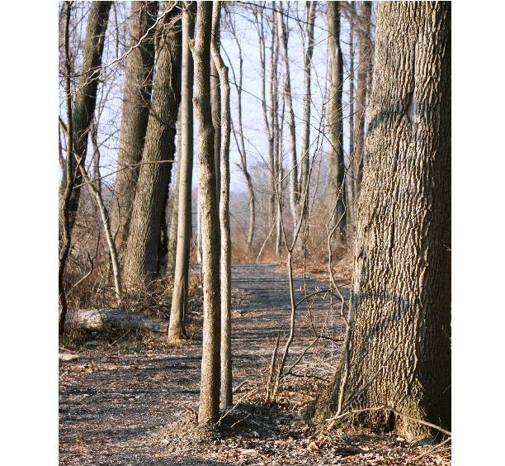
Centre Square Park Trail

Slide 46
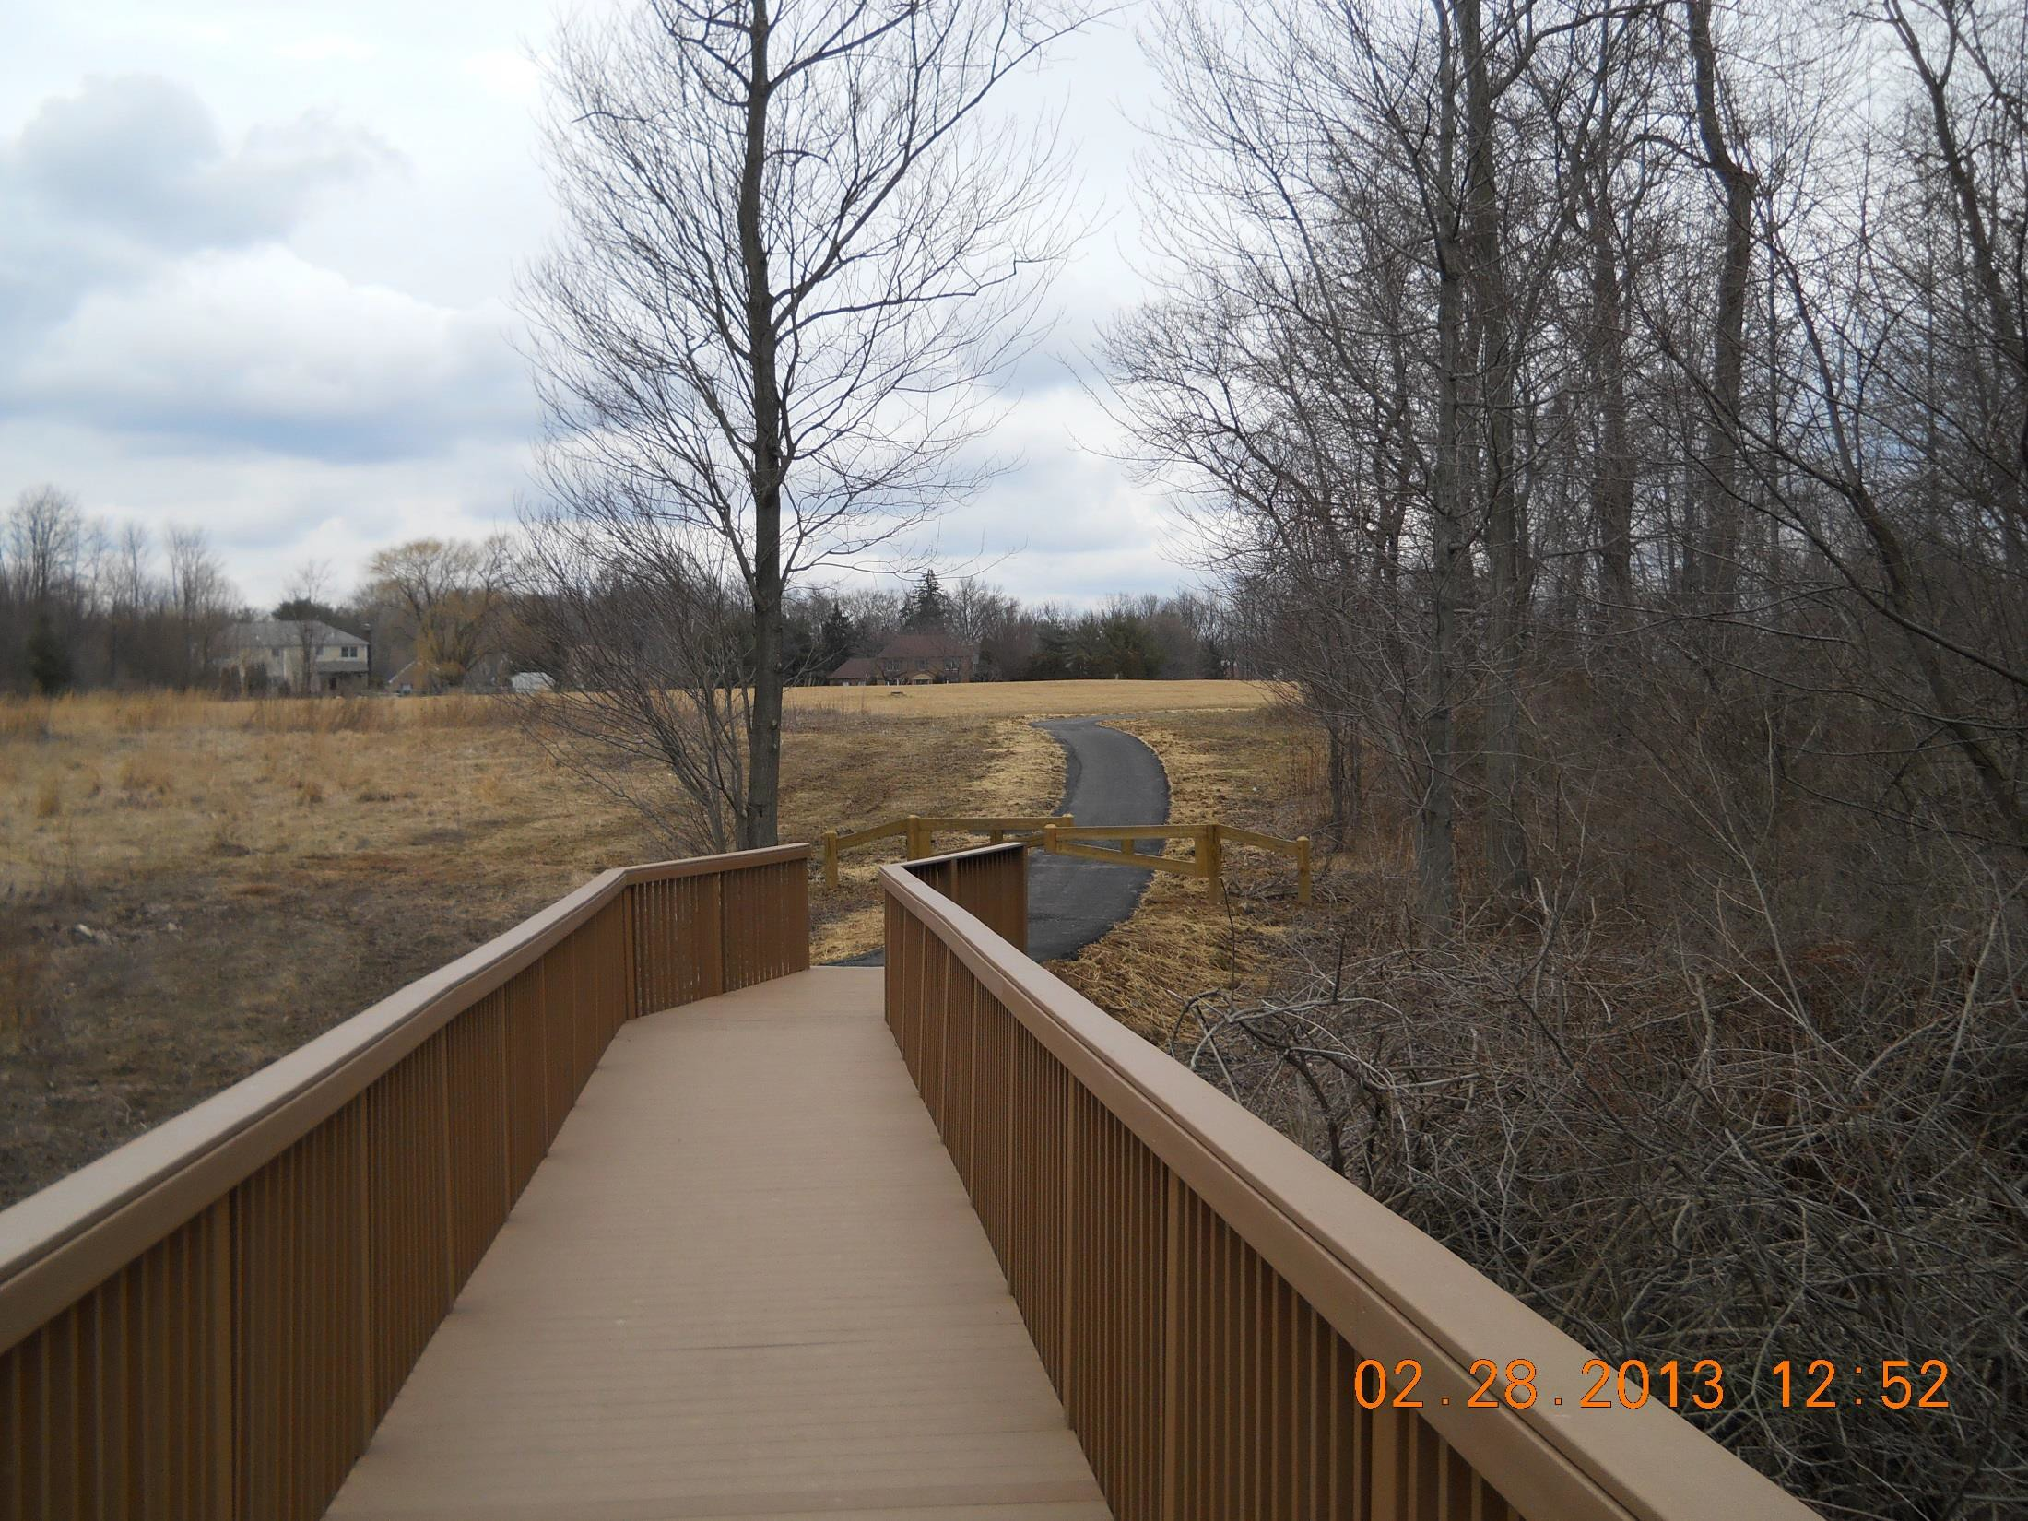
Narcissa Road Trail

Slide 47
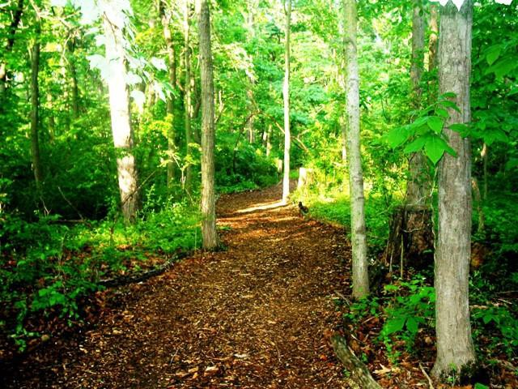
Wentz Run Nature Trail

Slide 48
Strategy #9
Adopt additional ordinances
Steep Slope Overlay District
Riparian Buffer Overlay District
Wooded Lot or Tree Replacement
Program
Historic Overlay District

Slide 49
